Slide 1
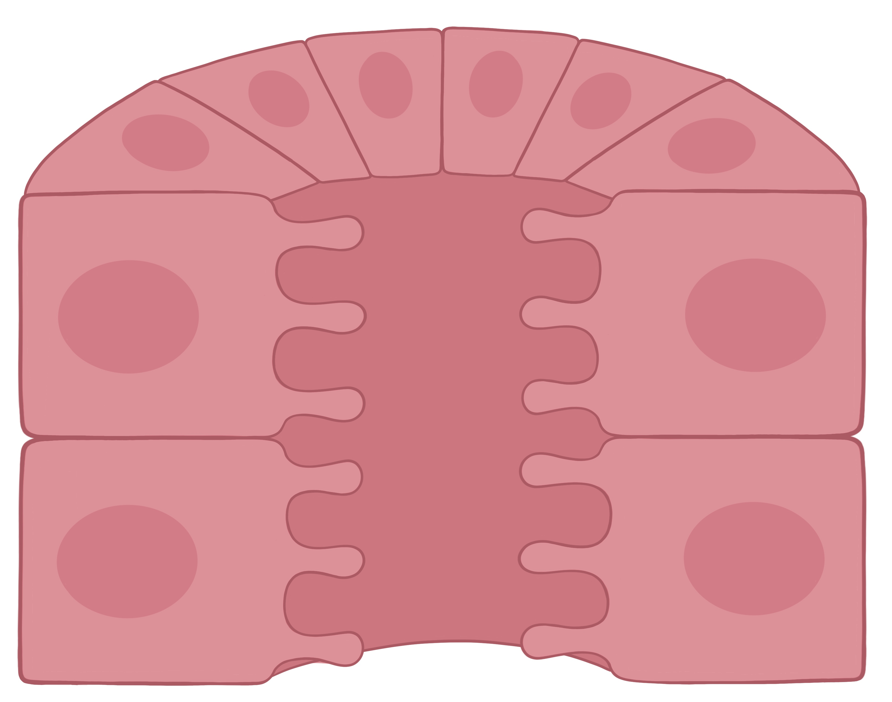







Transport of the Distal Convoluted Tubule
Apical Membrane
Basolateral Membrane
Tubule Lumen
3 Na⁺
3 Na⁺
Ca²⁺
Na⁺
+ATP
Ca²⁺
2 K⁺
Na⁺
Cl⁻
Cl⁻
K⁺
EveryBody Physiology
Artist: Danielle Xin
Notes:
Diagram Title: Transport of the Distal Convoluted Tubule
Description: This diagram depicts a cross-section of the distal convoluted tubule. Apical transporters include the sodium/chloride symporter (NCC), a sodium channel and calcium channel. The basolateral membrane has a potassium/chloride symporter, sodium, calcium exchanger and the sodium/potassium ATPase
Usage & Licensing:
This diagram is licensed under CC BY-NC-ND 4.0.
You may add or remove labels, rearrange layers, or adapt layout for educational use.
Attribution: Danielle Xin

