Slide 1
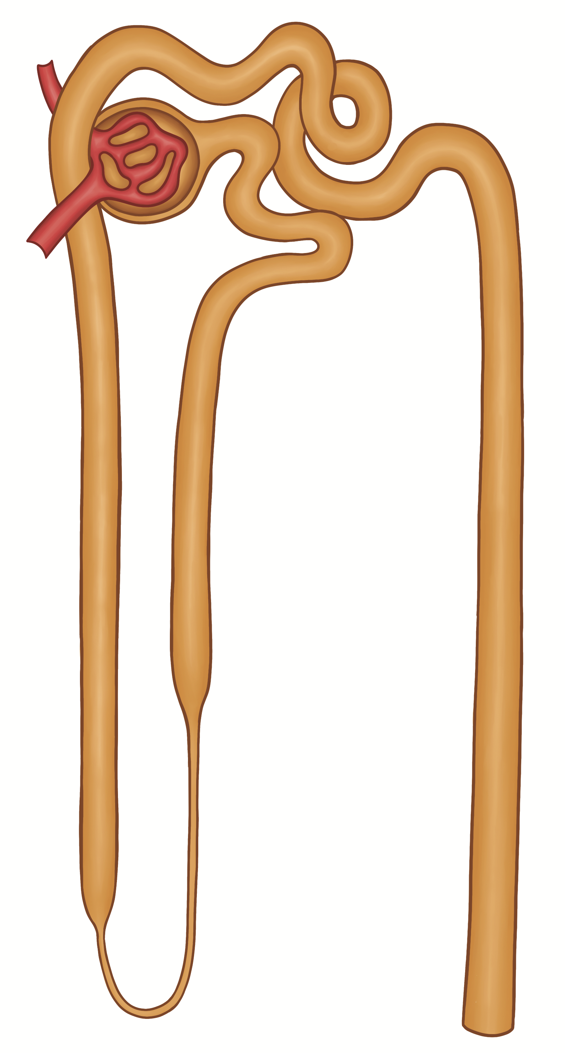
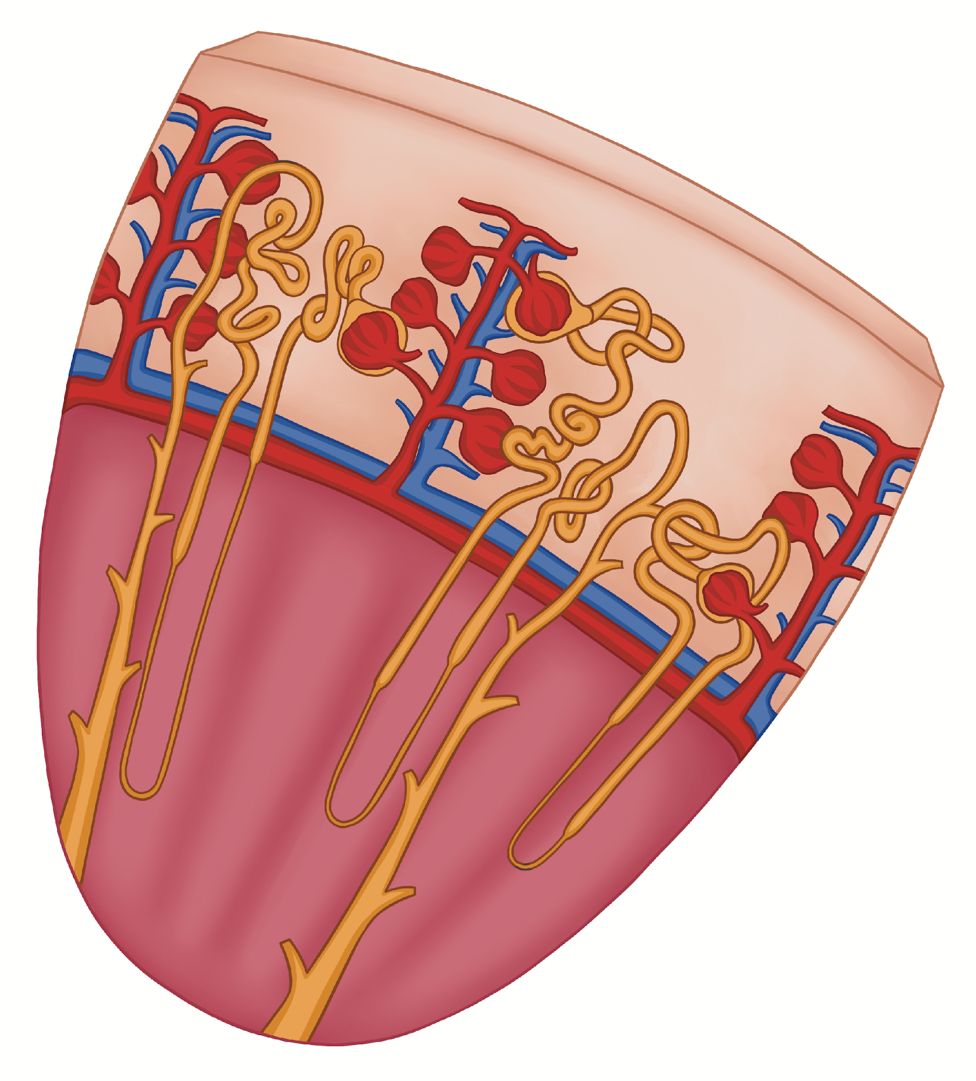

Nephrons within the Kidney Tissue
Distal Convoluted Tubule
Renal Corpuscle
Cortex
Proximal
Convoluted
Tubule
Collecting Duct
Ascending
Limb
Descending
Limb
Nephron
Medulla
Nephron Loop
EveryBody Physiology
Artist: Danielle Xin
Notes:
Diagram Title: Nephrons within the Kidney Tissue
Description: This diagram shows how nephrons are organized within kidney tissue, linking their microscopic structure to their position in the cortex and medulla. The left panel illustrates multiple nephrons embedded in renal tissue, while the right panel details the components of a single nephron, including the renal corpuscle, proximal and distal convoluted tubules, nephron loop, and collecting duct. The figure can be used to connect tissue-level organization with nephron anatomy and to reinforce how structural arrangement supports filtration, reabsorption, and urine concentration.
Usage & Licensing:
This diagram is licensed under CC BY-NC-ND 4.0.
You may add or remove labels, rearrange layers, or adapt layout for educational use.
Attribution: Danielle Xin

