Slide 1
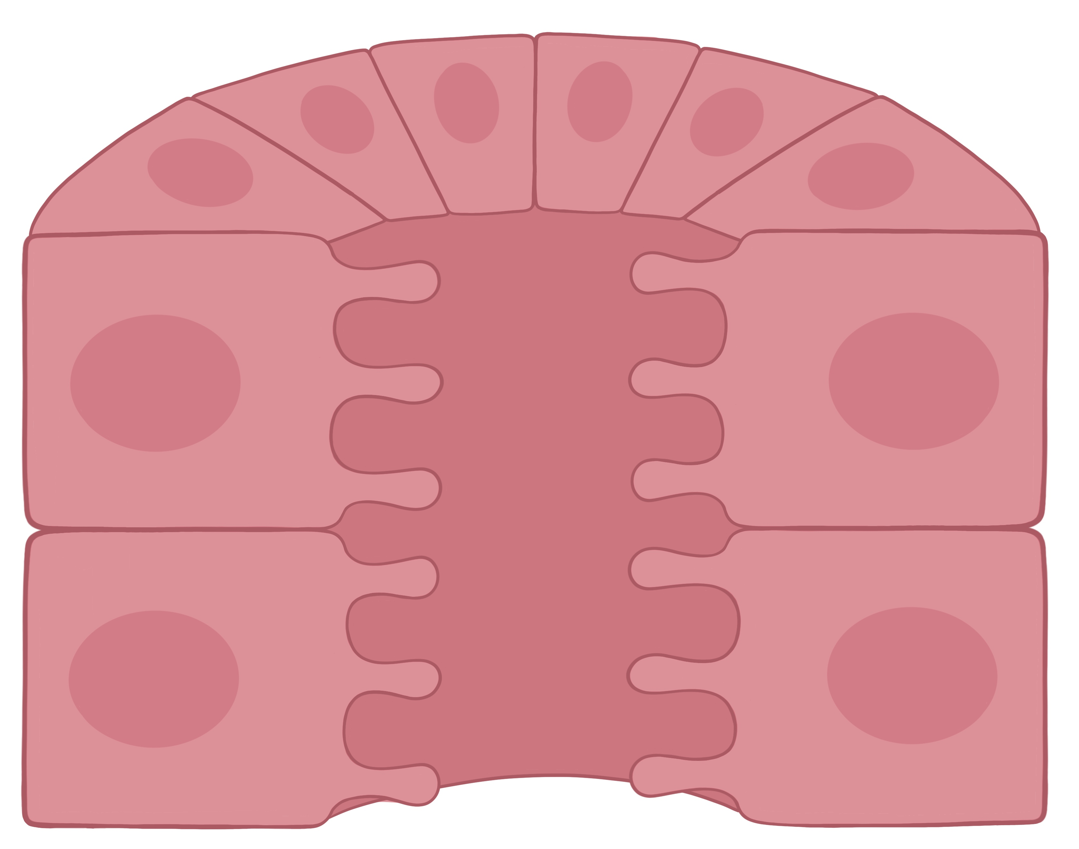
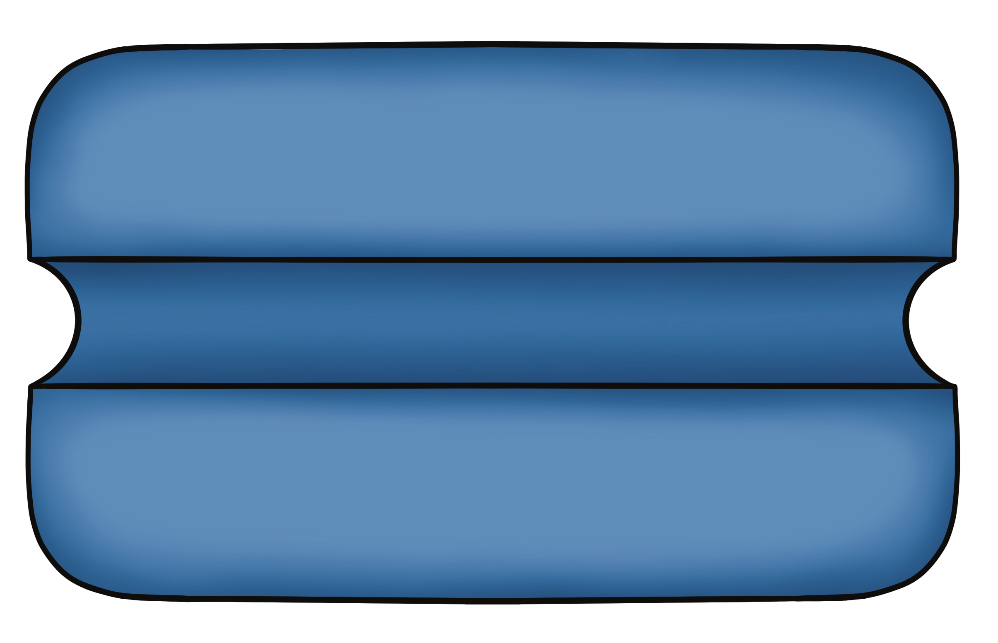
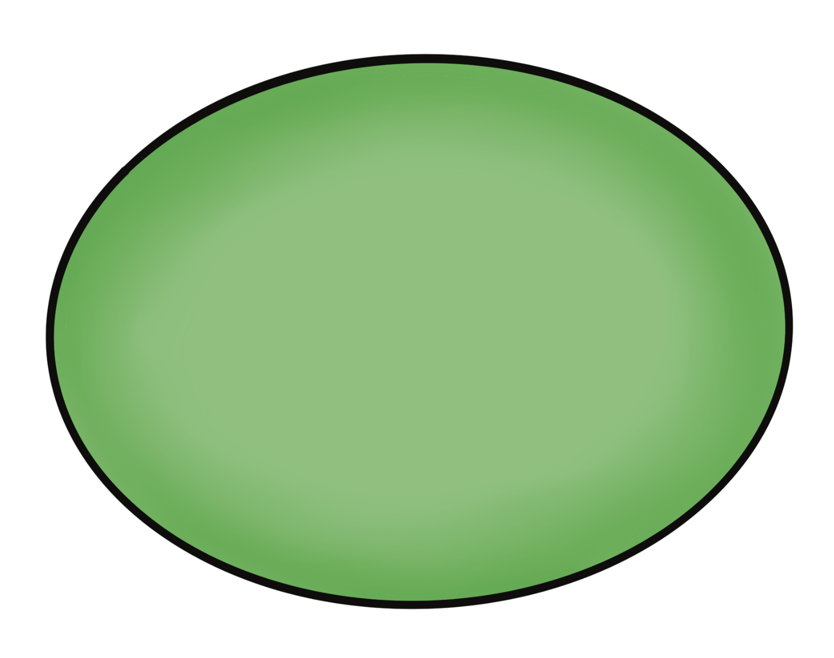
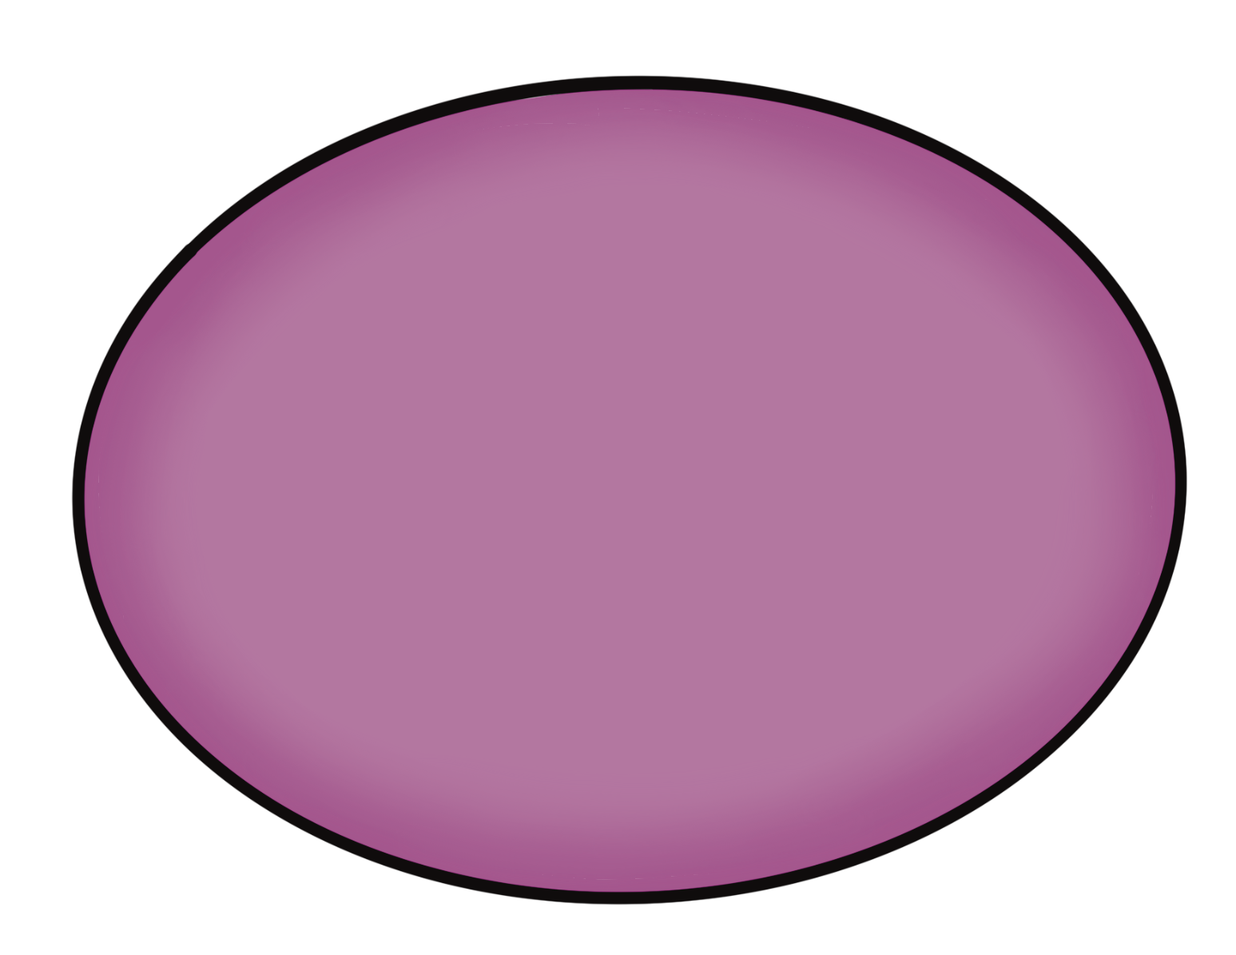
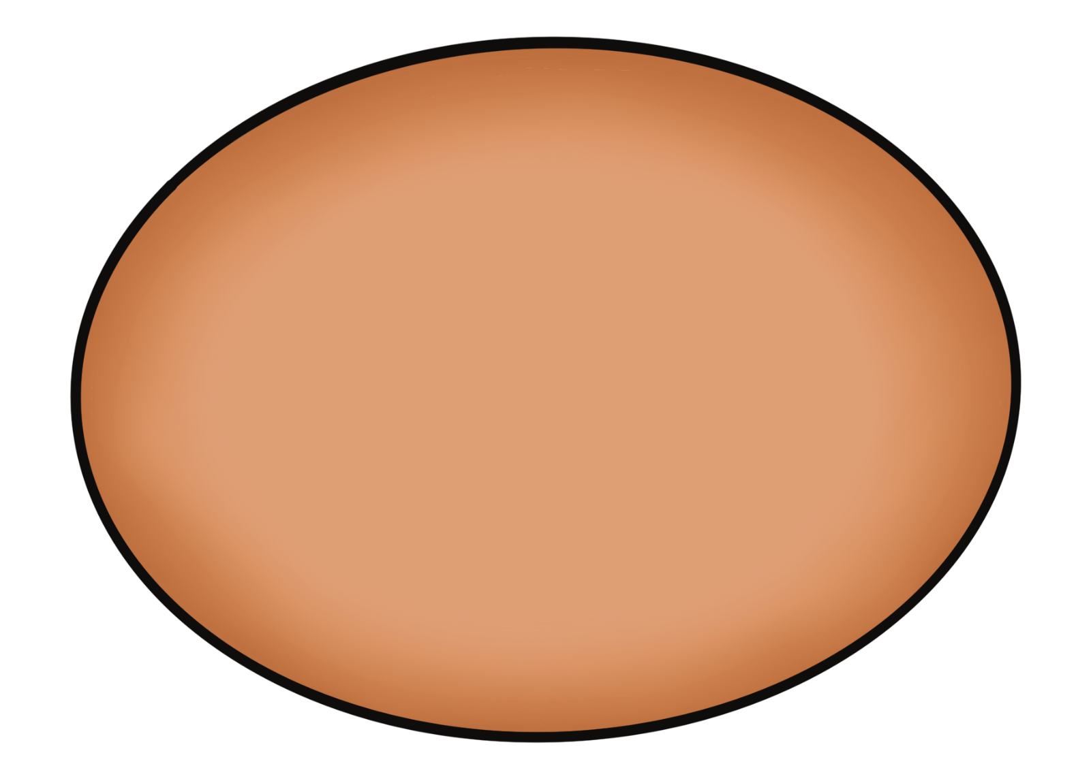
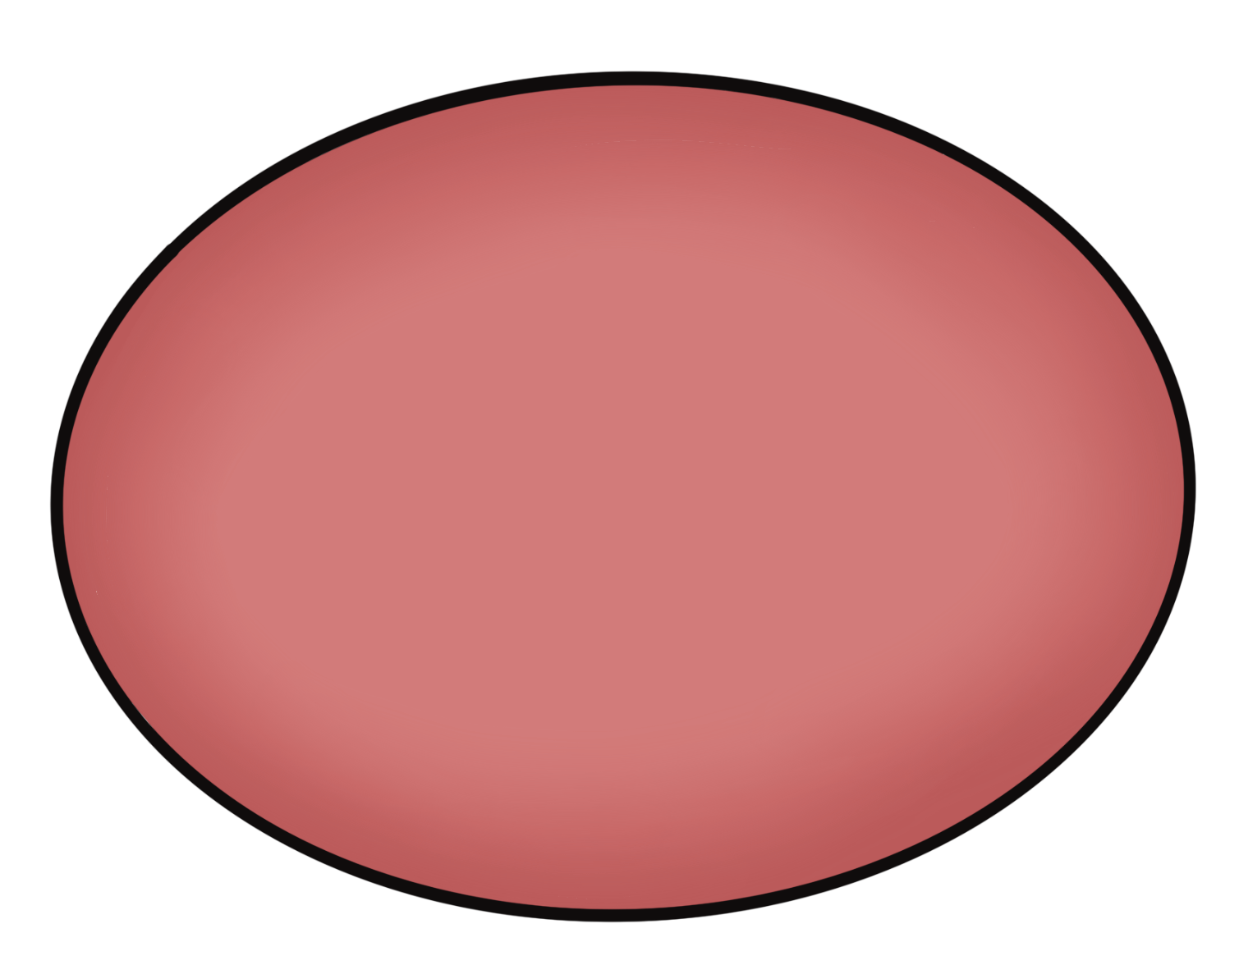
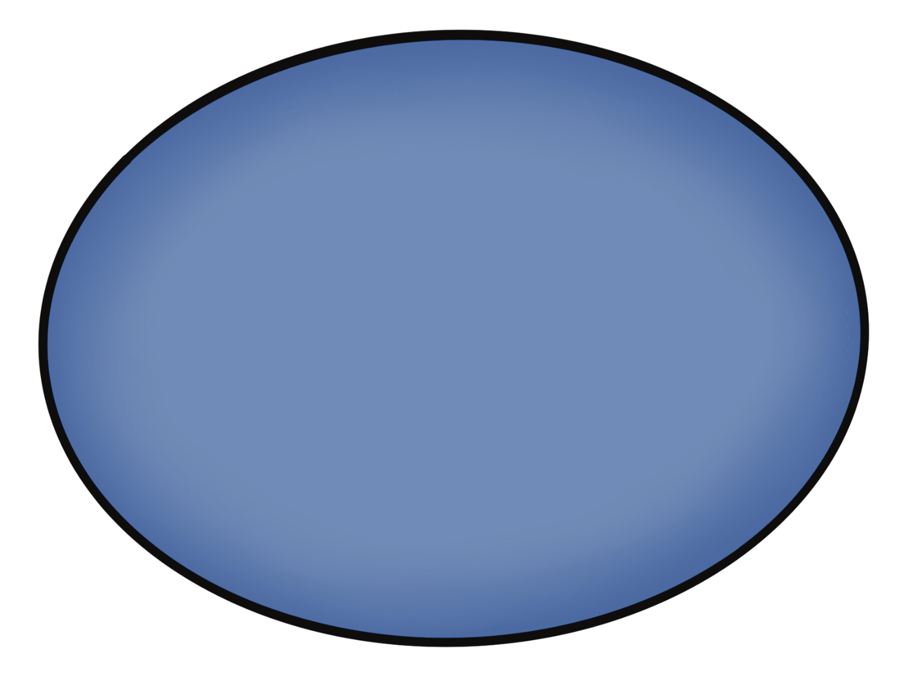
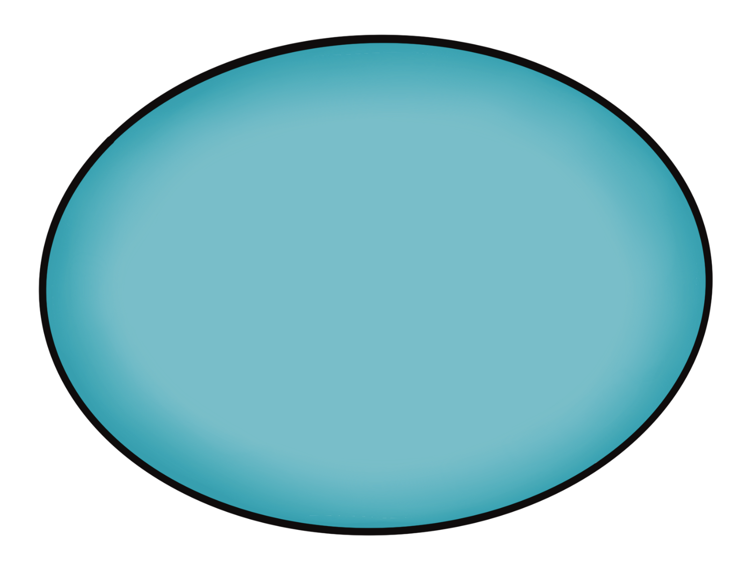

Transport of the Proximal Tubule
Apical Membrane
Basolateral Membrane
Tubule Lumen
Na⁺
3 Na⁺
H₂O
H₂O
+ATP
H⁺
2 K⁺
K⁺, C^{l-}, H₂O
Na⁺
Na⁺
Amino Acids
Amino Acids
Glucose
Glucose
EveryBody Physiology
Artist: Danielle Xin
Notes:
Diagram Title: Transport of the Proximal Tubule
Description: This diagram depicts a cross-section of the proximal tubule, with some of the major transport that occurs in this tubule region. Apical transporters include the sodium/hydrogen exchange, the sodium/glucose symporter, and the sodium/amino acid symporter. Basolateral transporters include a glucose uniporter, amino acid uniporter and the sodium/potassium ATPase. Water cross the membranes through apical and basolateral aquaporins. Paracellular reabsorption includes transporter of potassium, chloride and water.
Usage & Licensing:
This diagram is licensed under CC BY-NC-ND 4.0.
You may add or remove labels, rearrange layers, or adapt layout for educational use.
Attribution: Danielle Xin

