Slide 1
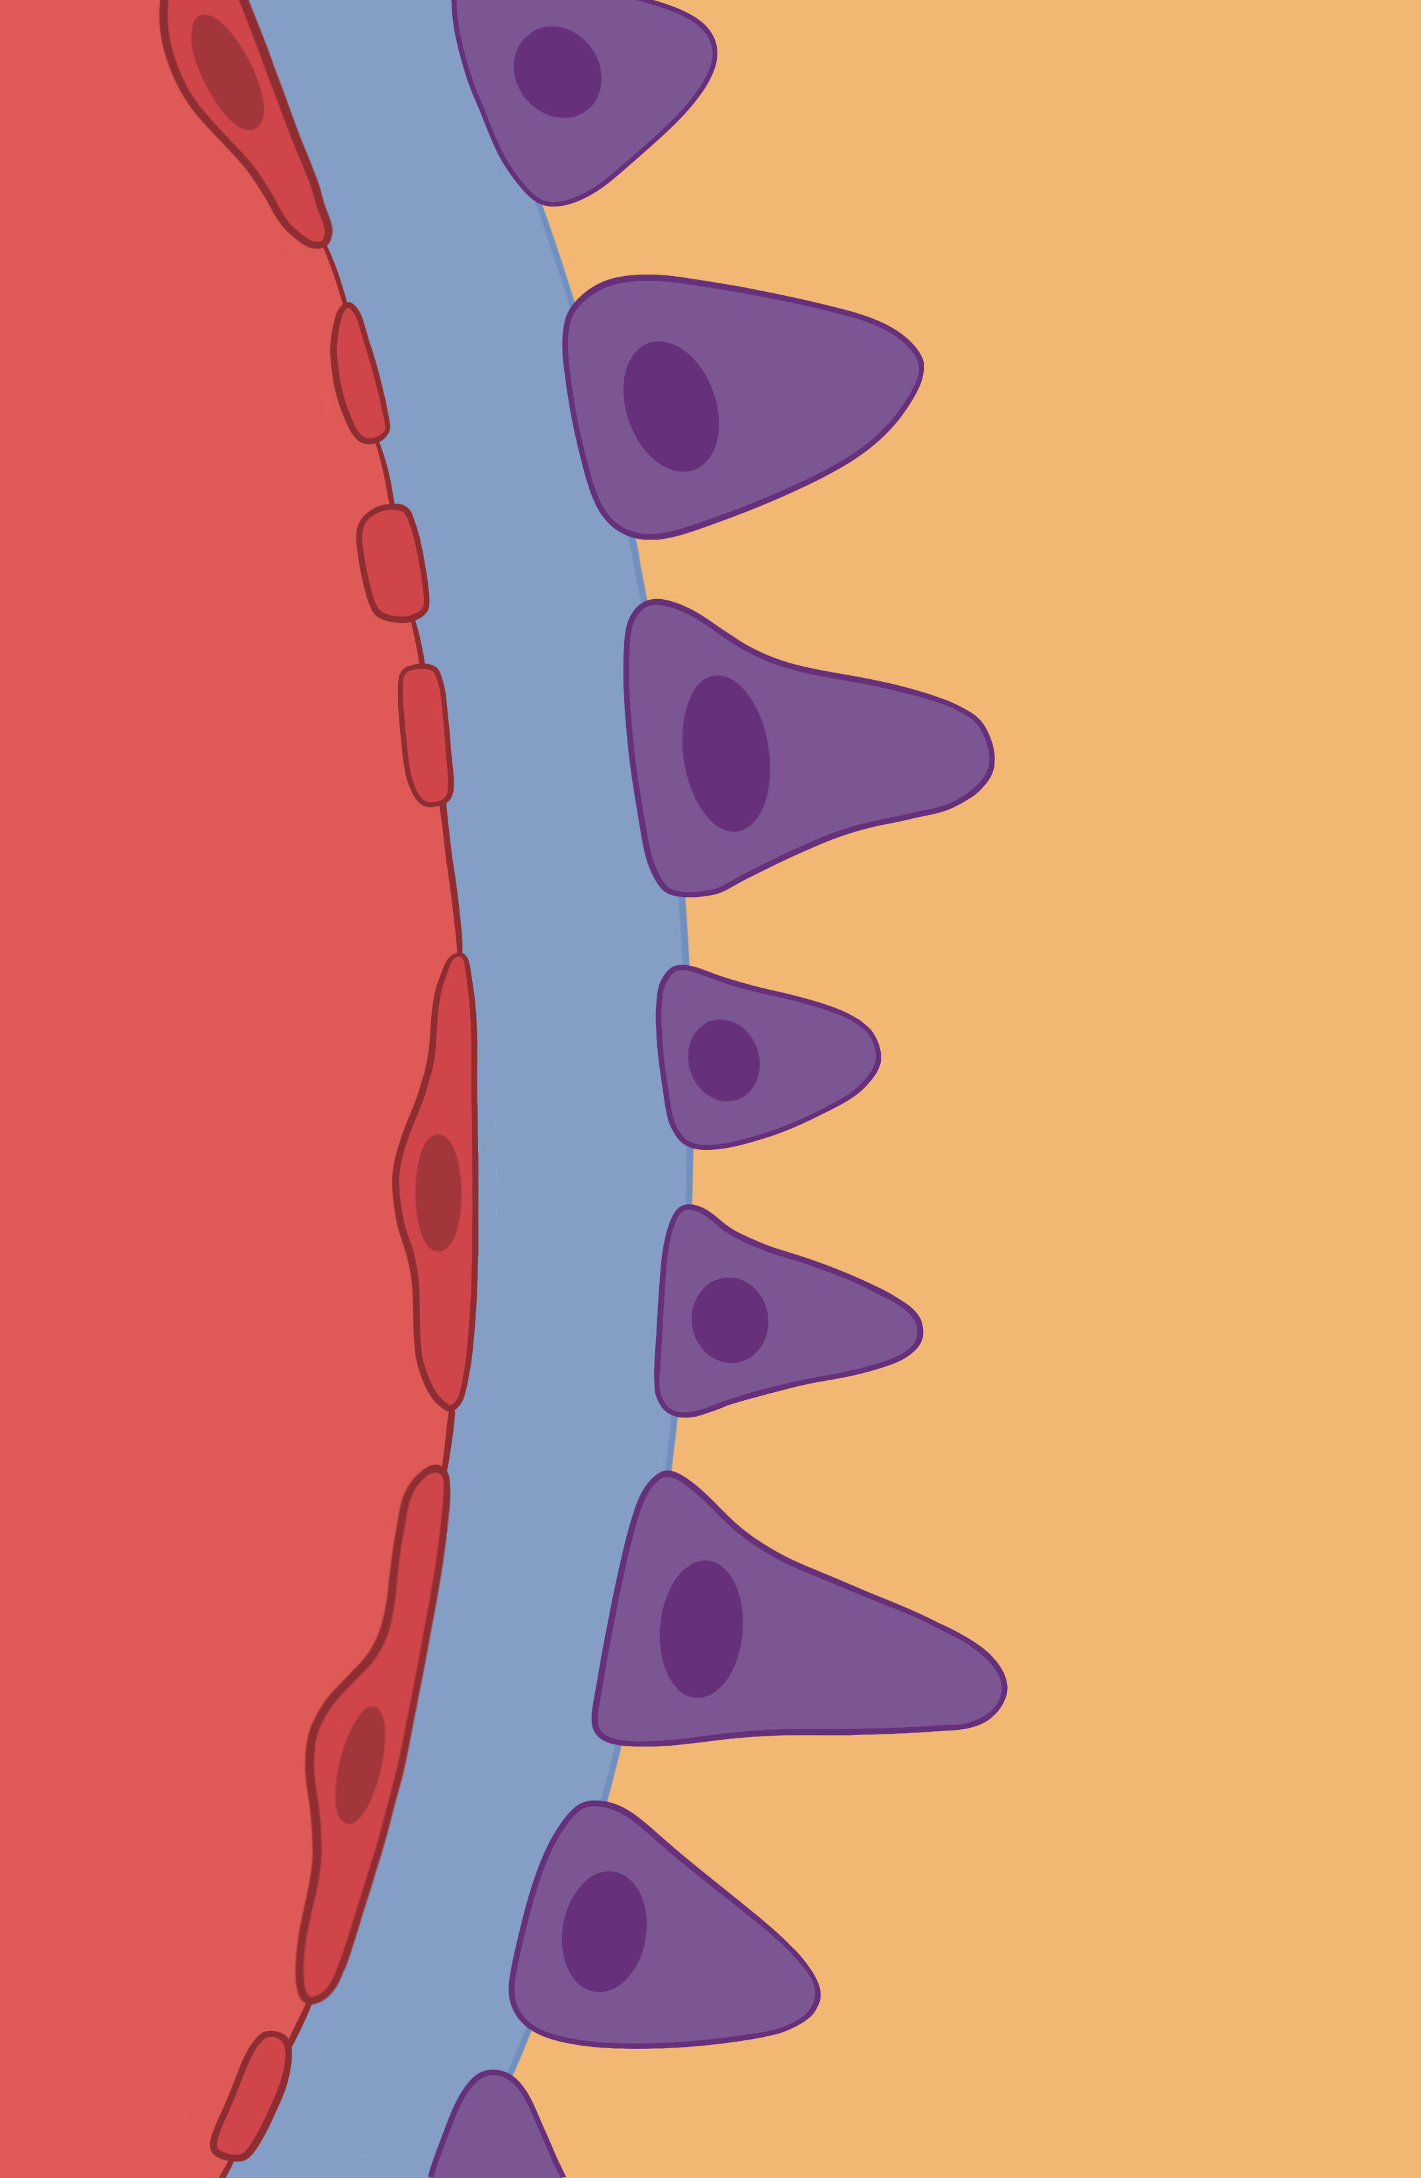

The Cross-Section of the Renal Capsule
Endothelial Cell
Podocyte
Basal Lamina
Slit Space
Glomerular Capillary
Capsular Space
EveryBody Physiology
Artist: Danielle Xin
Notes:
Diagram Title: The Cross-Section of the Renal Capsule
Description: This diagram depicts the cross-section of the renal capsule, the filtering unit of the nephron. The image highlights the connection between the glomerulus to podocytes, demonstrating the barriers to filtration. The fenestrations of the glomerular capillary, and intercellular clefts between endothelial cells permits the movement of most items from the blood, excluding red blood cells, white blood cells and larger proteins. The basal lamina, an extracellular matrix composed of mostly type IV collagen and negatively charged glycoproteins, attaches the endothelial cells of the glomerulus to podocytes, and serves as a further barrier to the filtration of smaller proteins. Podocytes wrap around the glomerular capillary,
Usage & Licensing:
This diagram is licensed under CC BY-NC-ND 4.0.
You may add or remove labels, rearrange layers, or adapt layout for educational use.
Attribution: Danielle Xin

