Slide 1
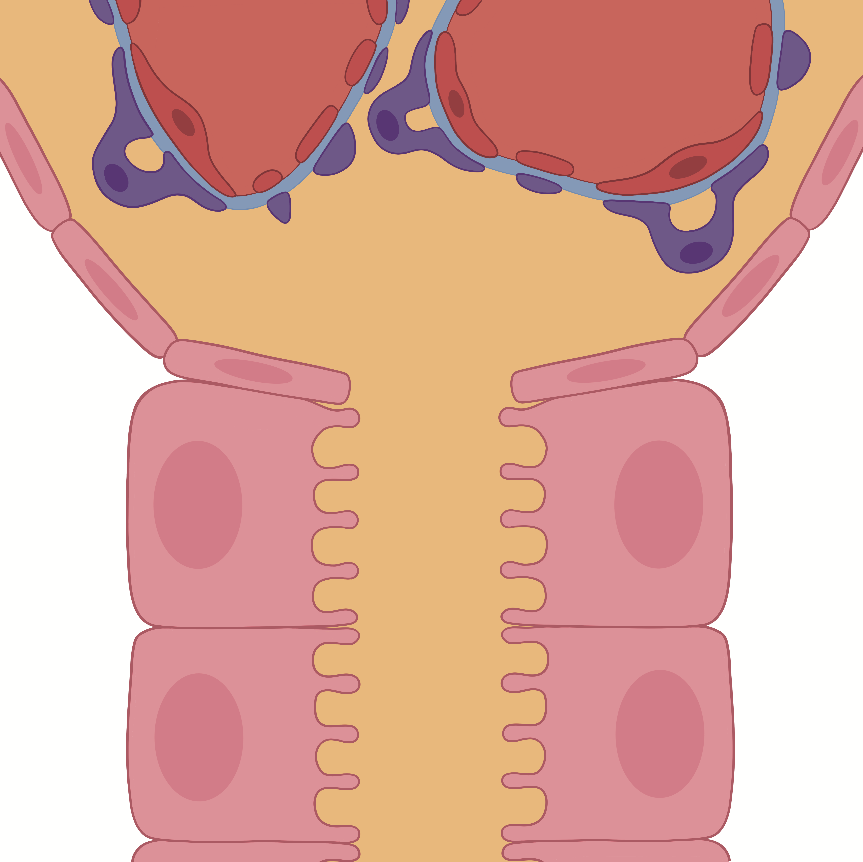

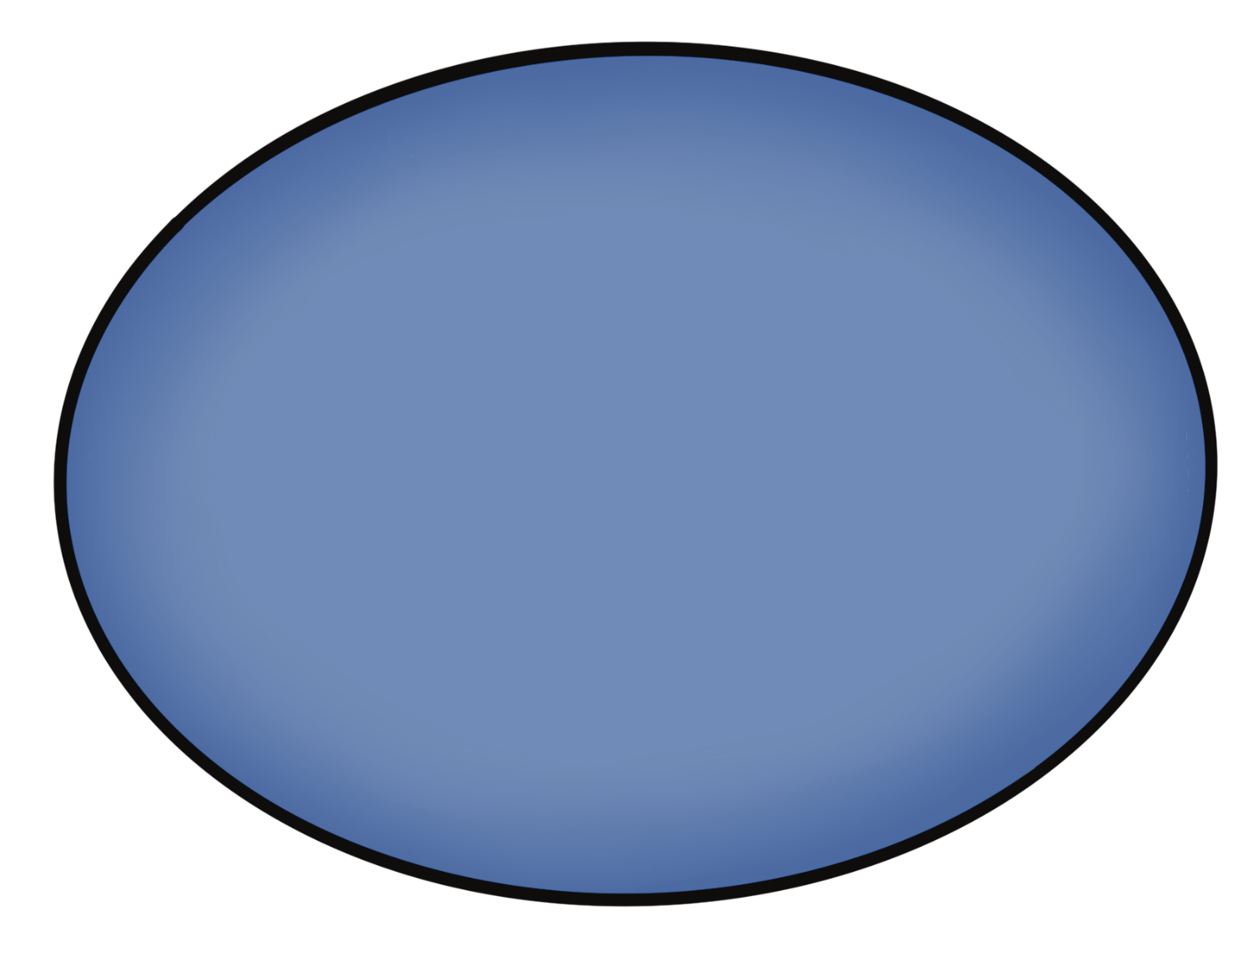

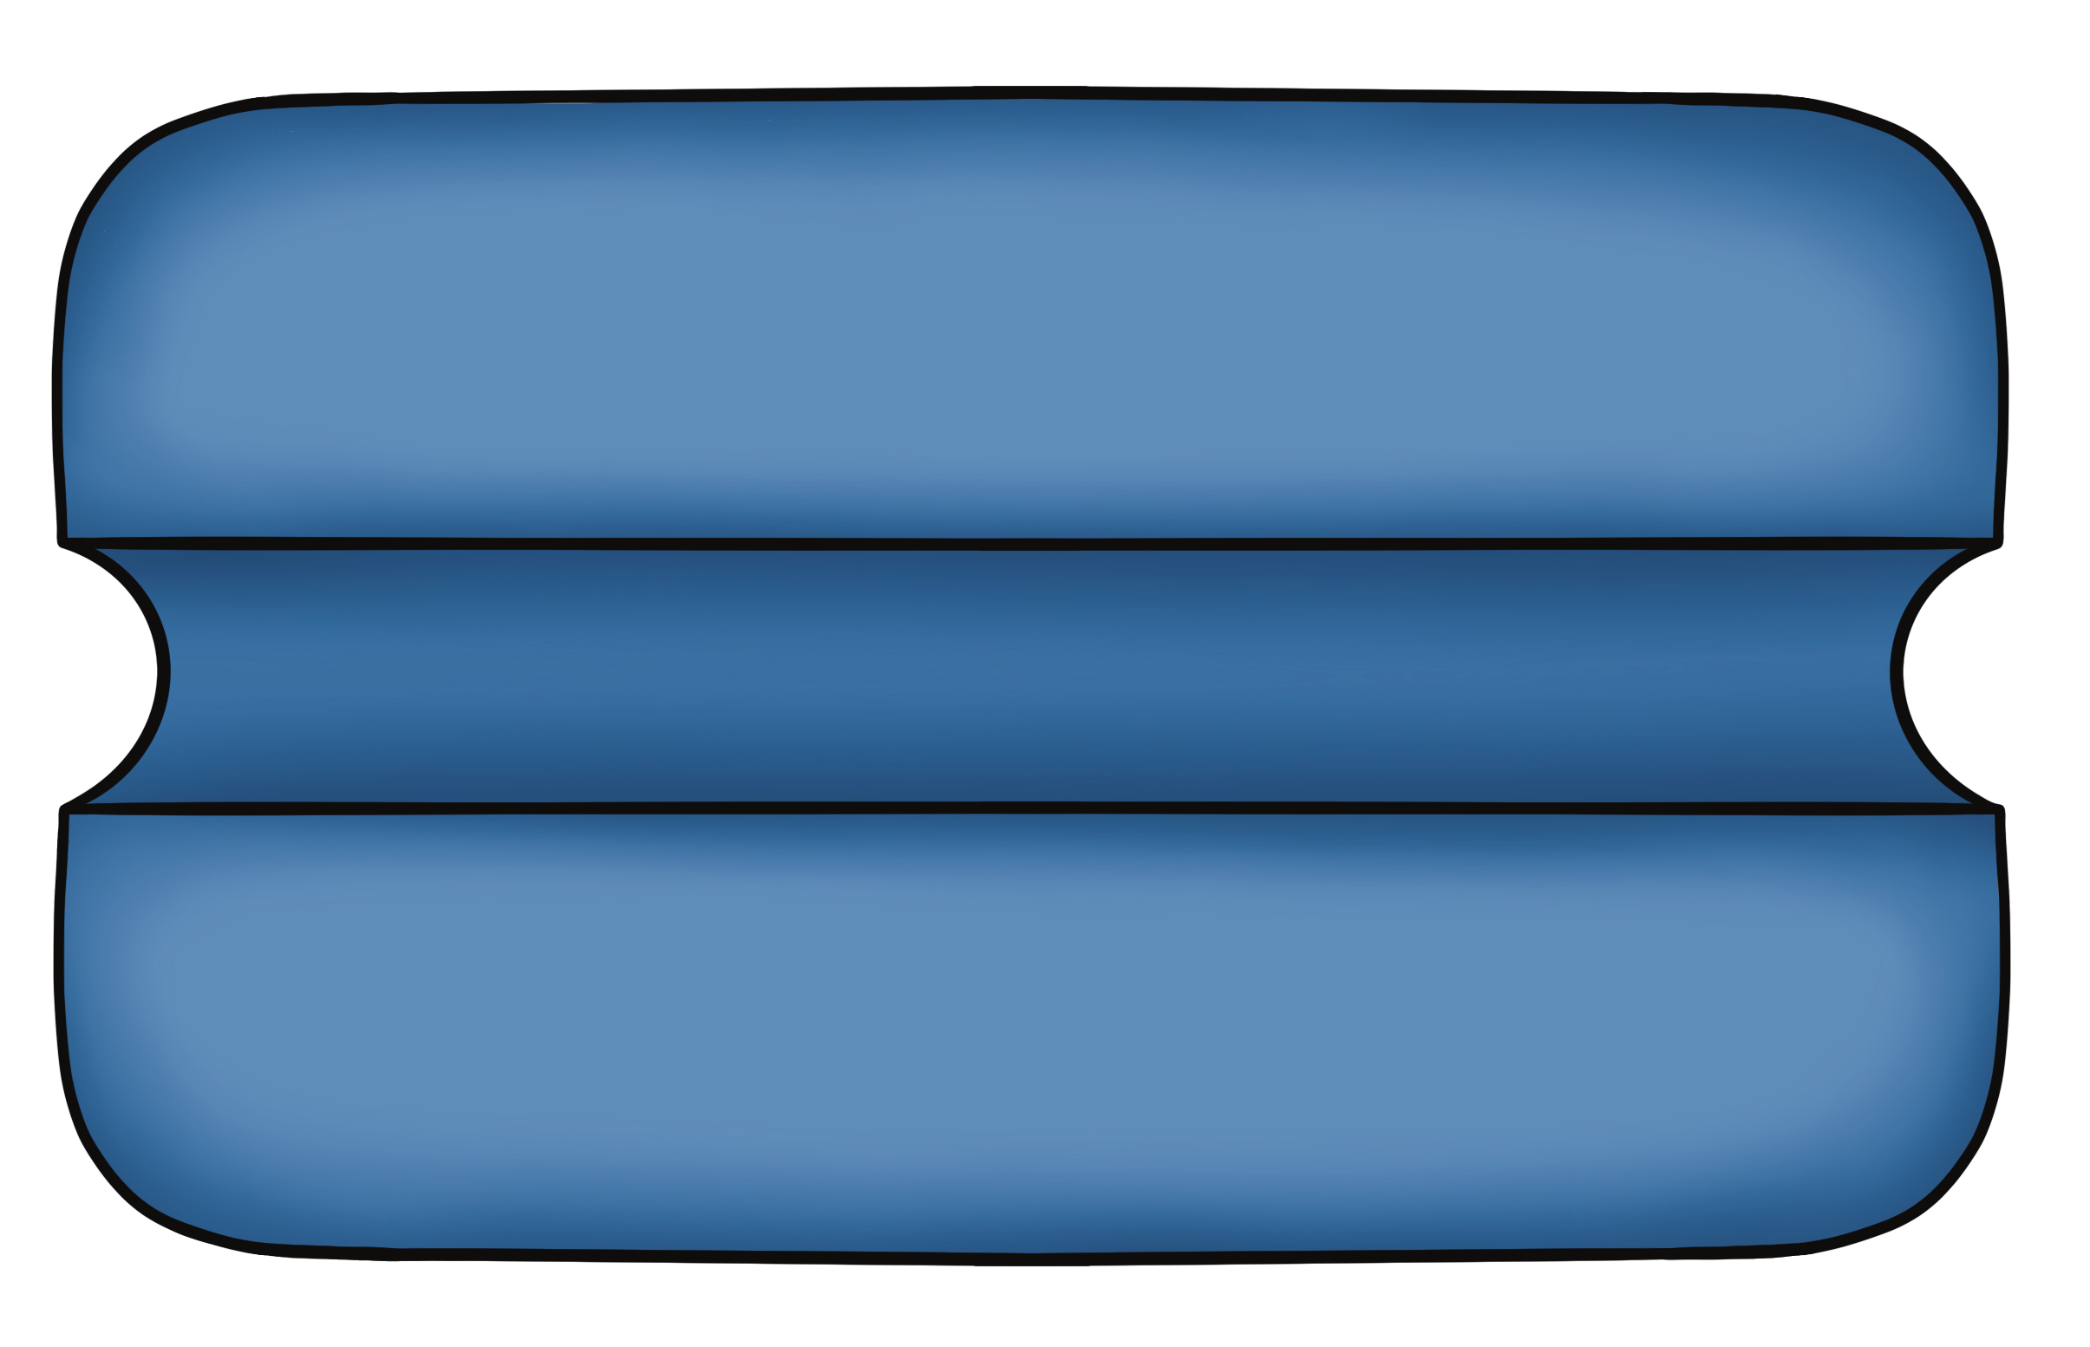

Bicarbonate Handling by the Proximal Tubule
HCO₃⁻
Na⁺
Na⁺
HCO₃⁻
+
H⁺
HCO₃⁻
HCO₃⁻
H⁺
+
H₂CO₃
H₂CO₃
CA
CA
H₂O
CO₂
CO₂
H₂O
+
+
EveryBody Physiology
Artist: Danielle Xin
Notes:
Diagram Title: Bicarbonate Handling by the Proximal Tubule
Description: This diagram supports the teaching of how bicarbonate is reabsorbed in the proximal tubule. Showing the filtration of bicarbonate from the glomerulus into the capsular space, bicarbonate combines with secreted hydrogen ions to form carbonic acid. A membrane bound carbonic anhydrase (CA) catalyzes the formation of carbon dioxide and water. Water is reabsorbed across the apical membrane of proximal tubule cells through an apical aquaporin. Intracellularly, water combines with carbon dioxide, catalyzed by a cytosolic CA to form carbonic acid, which quickly dissociates into bicarbonate and a hydrogen ion. Bicarbonate is reabsorbed across the basolateral membrane on a sodium/bicarbonate symporter into the interstitial space, and then into the capillaries that surround the proximal tubule.
Usage & Licensing:
This diagram is licensed under CC BY-NC-ND 4.0.
You may add or remove labels, rearrange layers, or adapt layout for educational use.
Attribution: Danielle Xin

