Slide 1
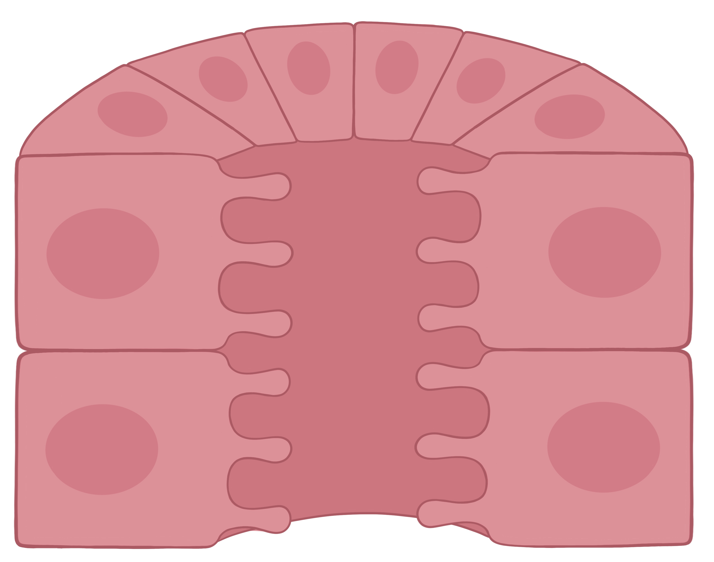
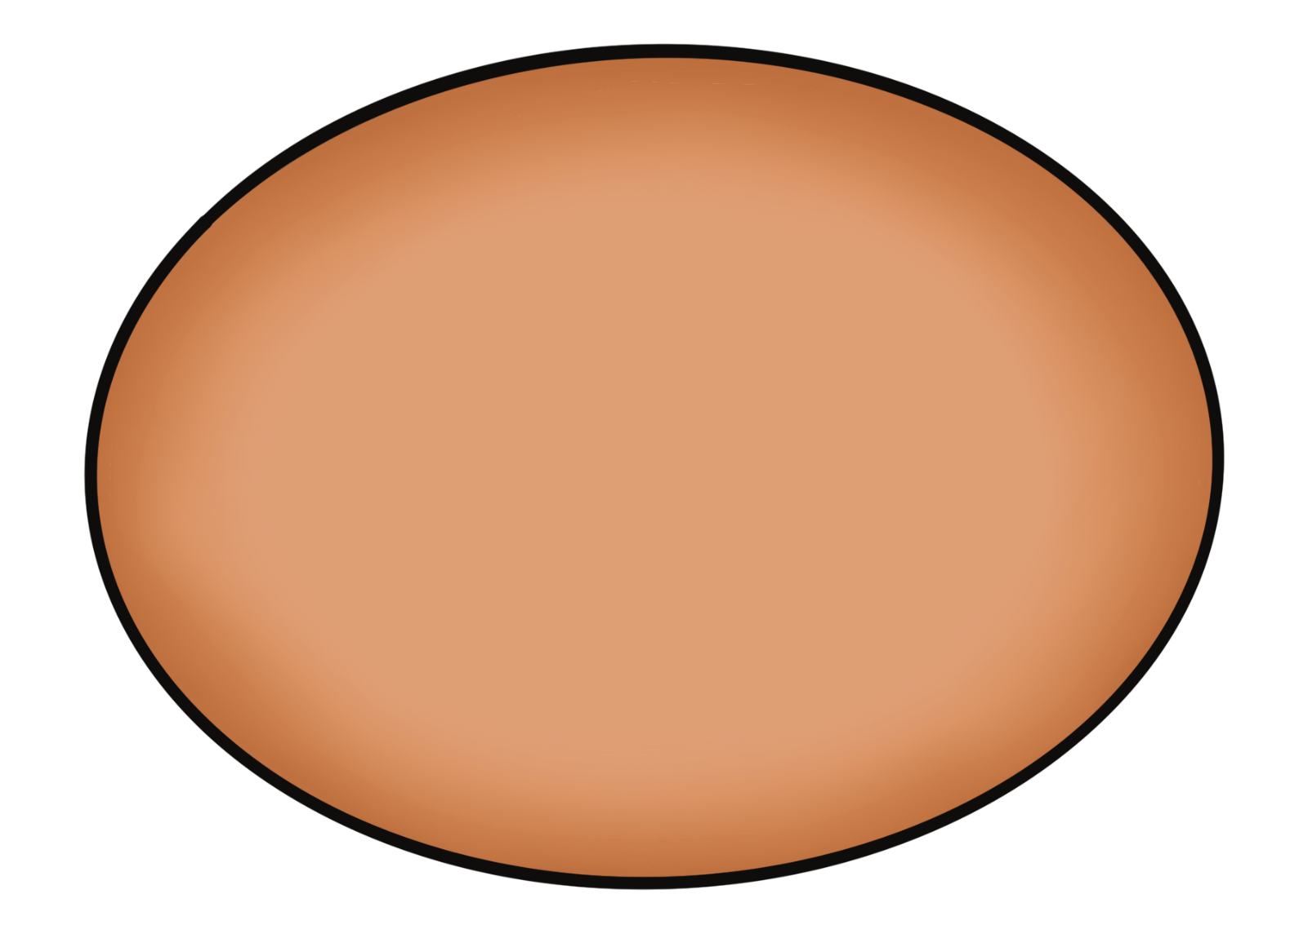
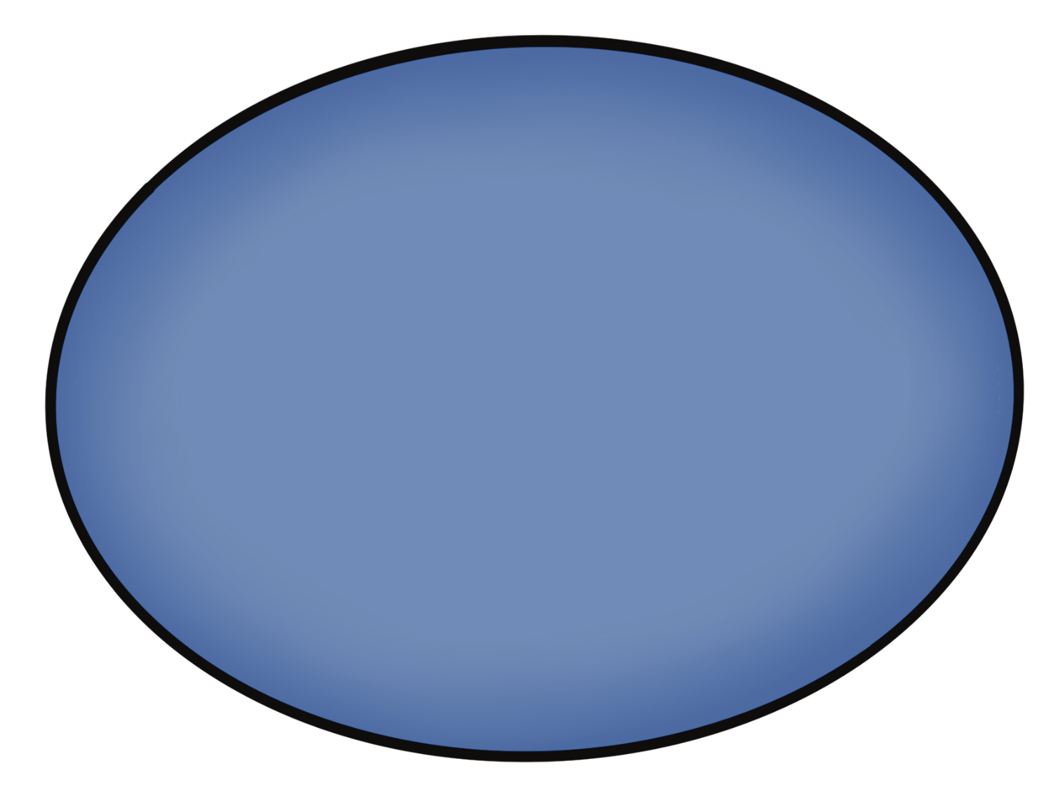
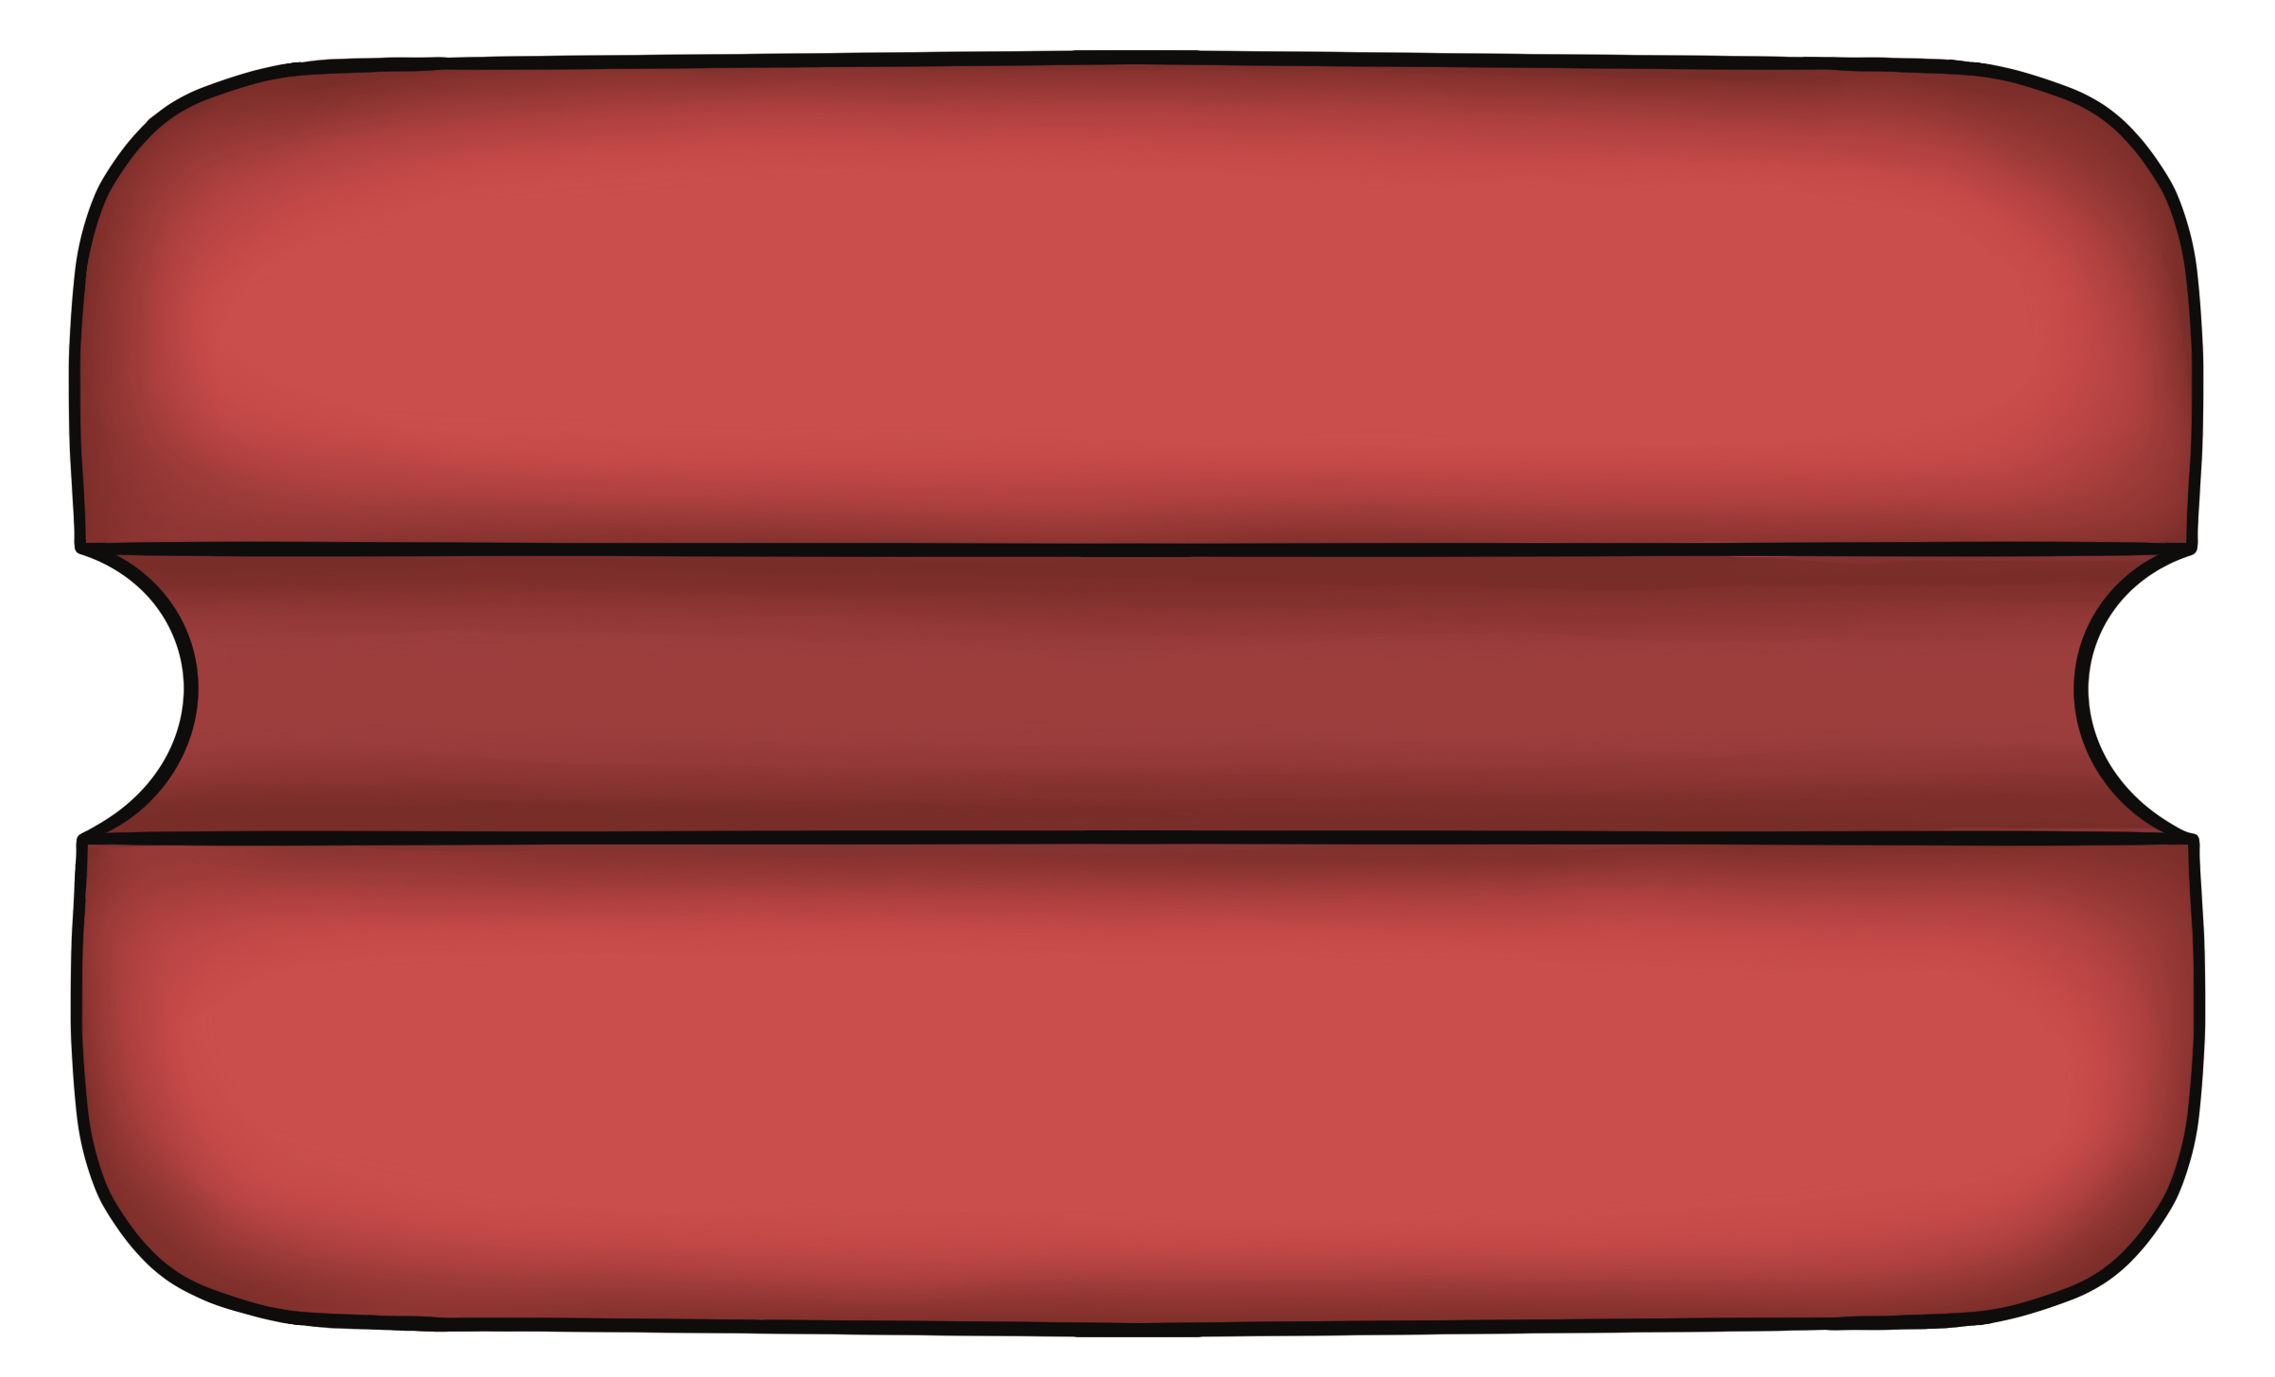
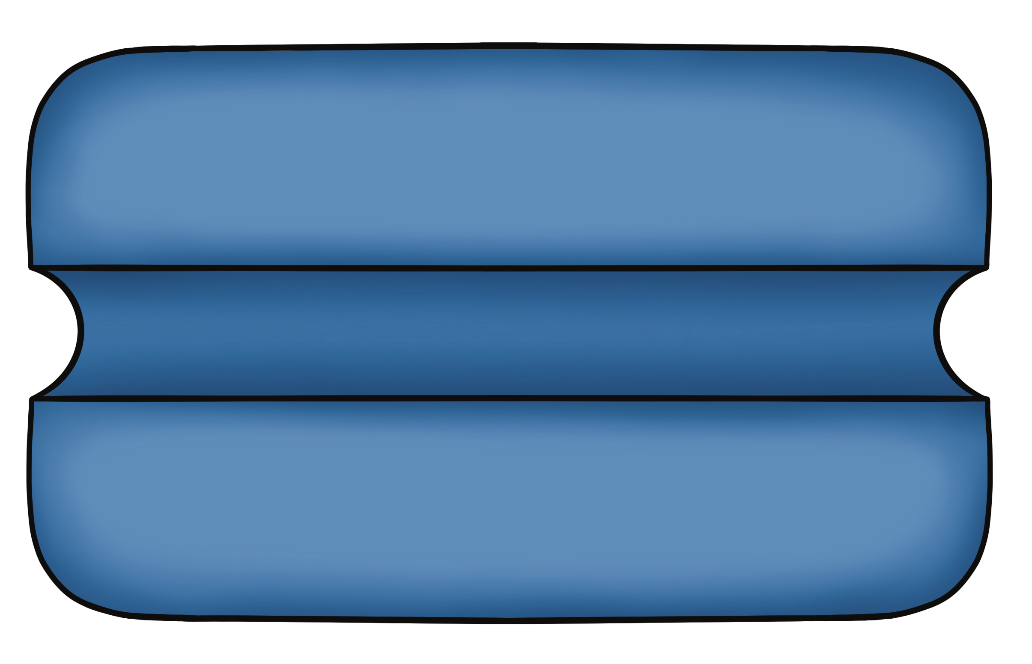
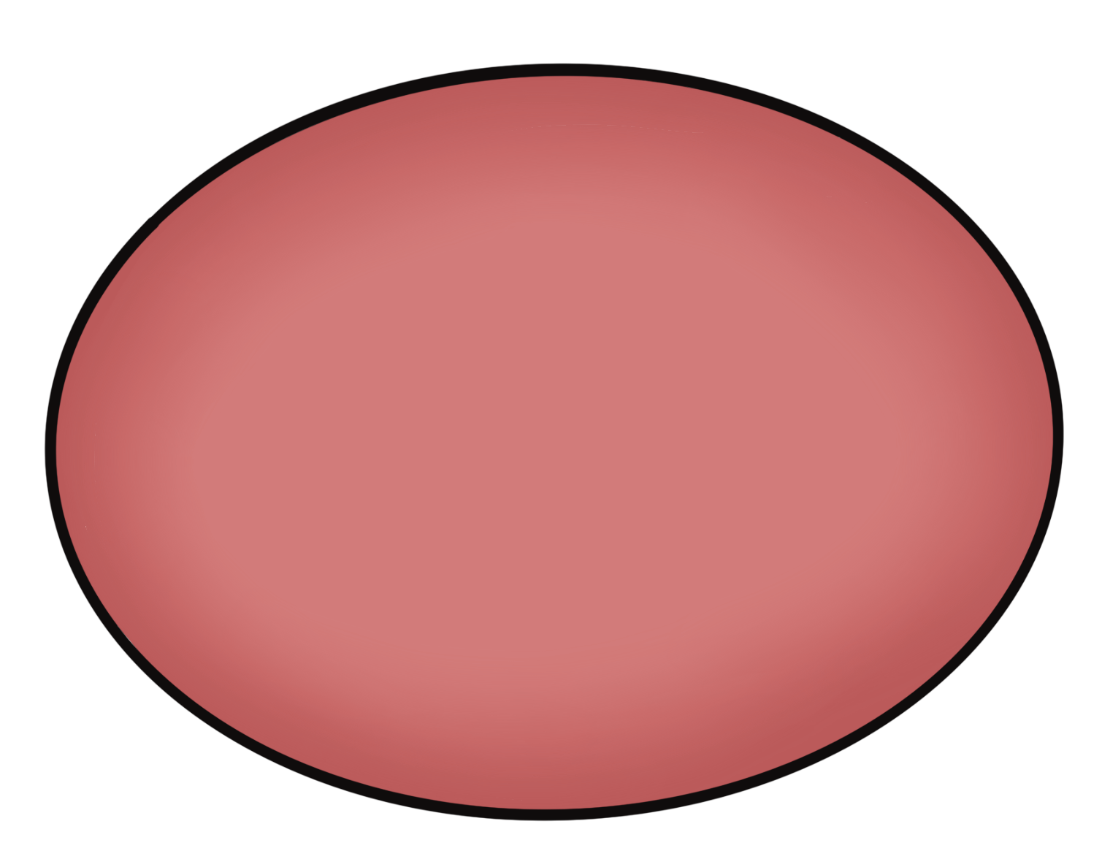
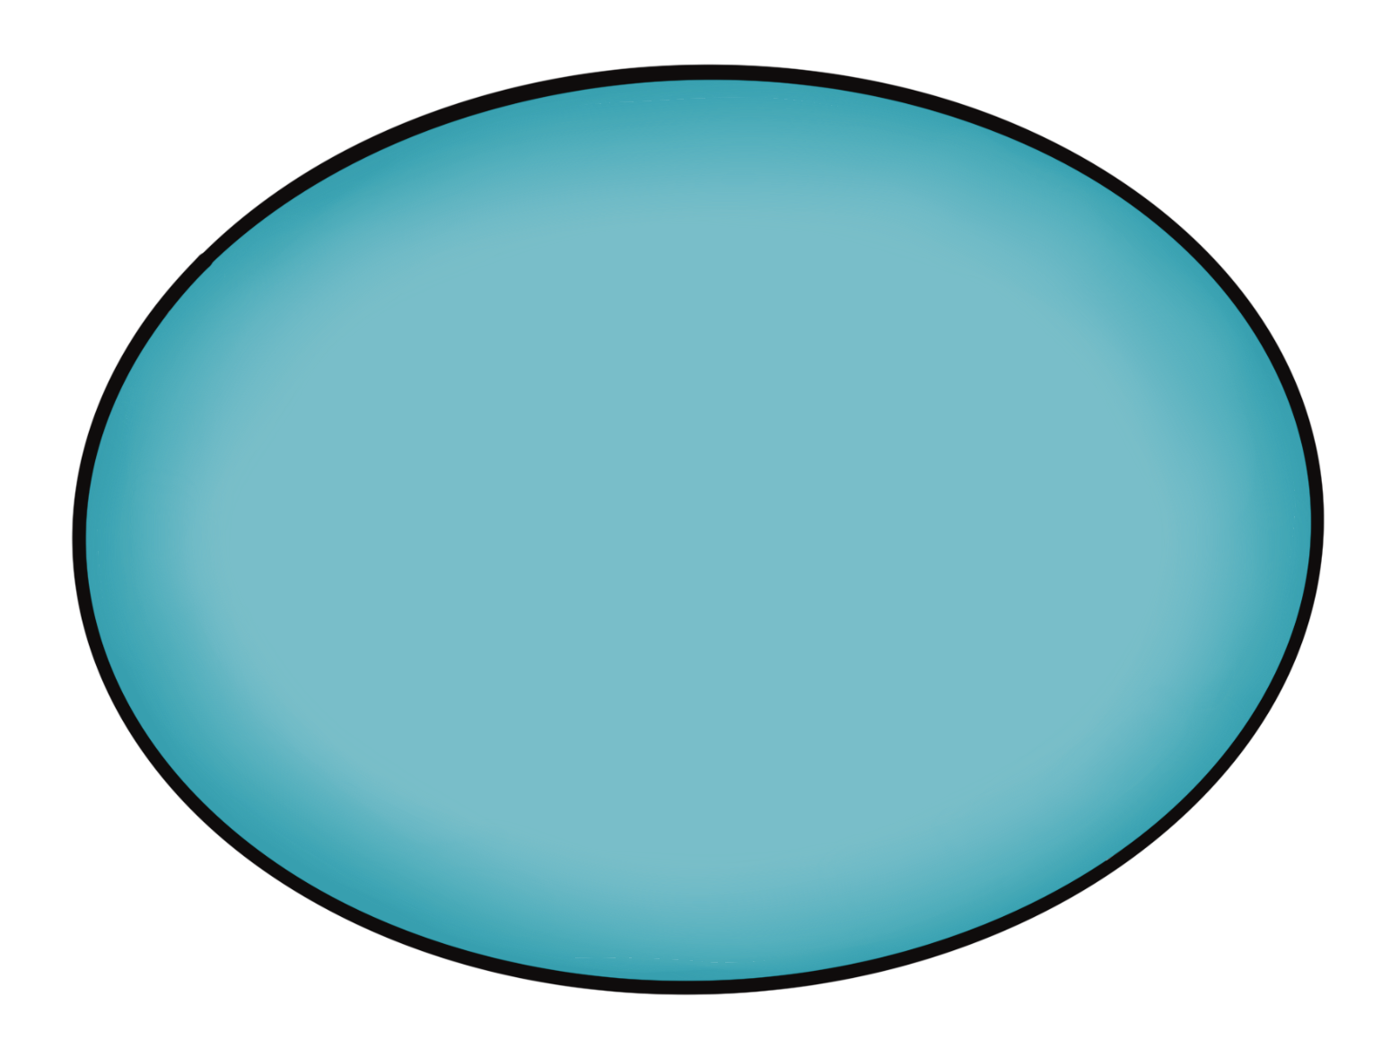
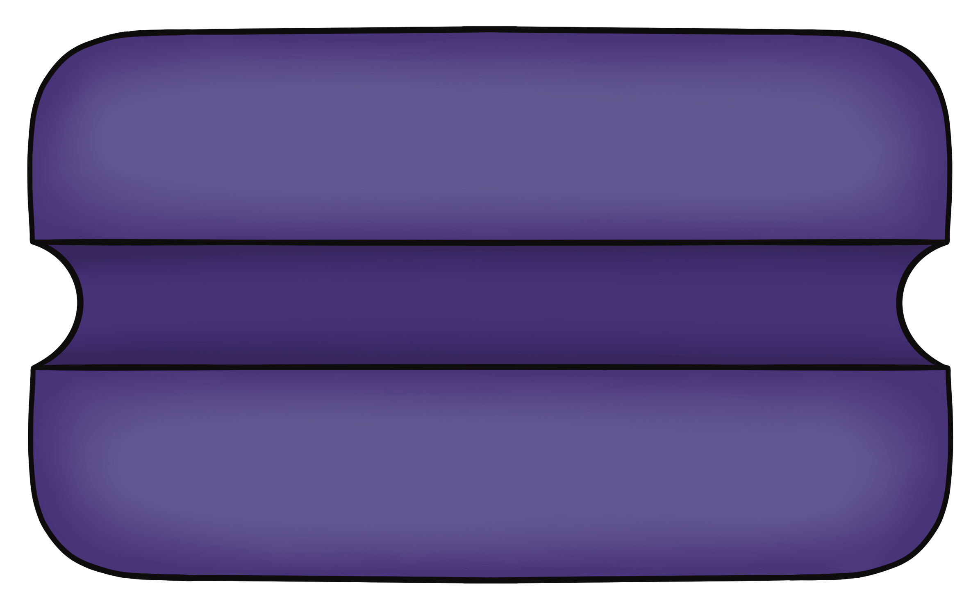
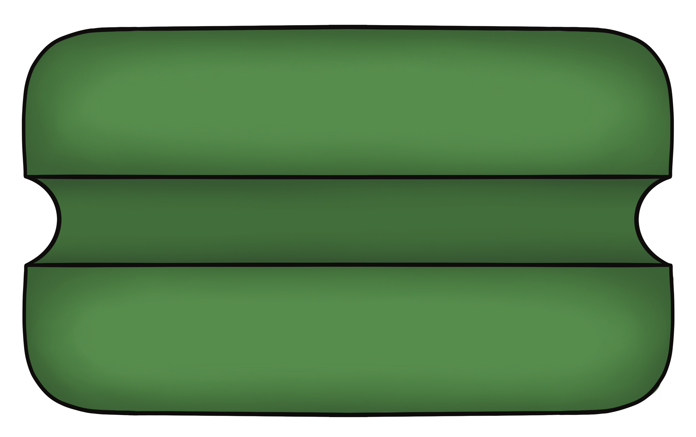
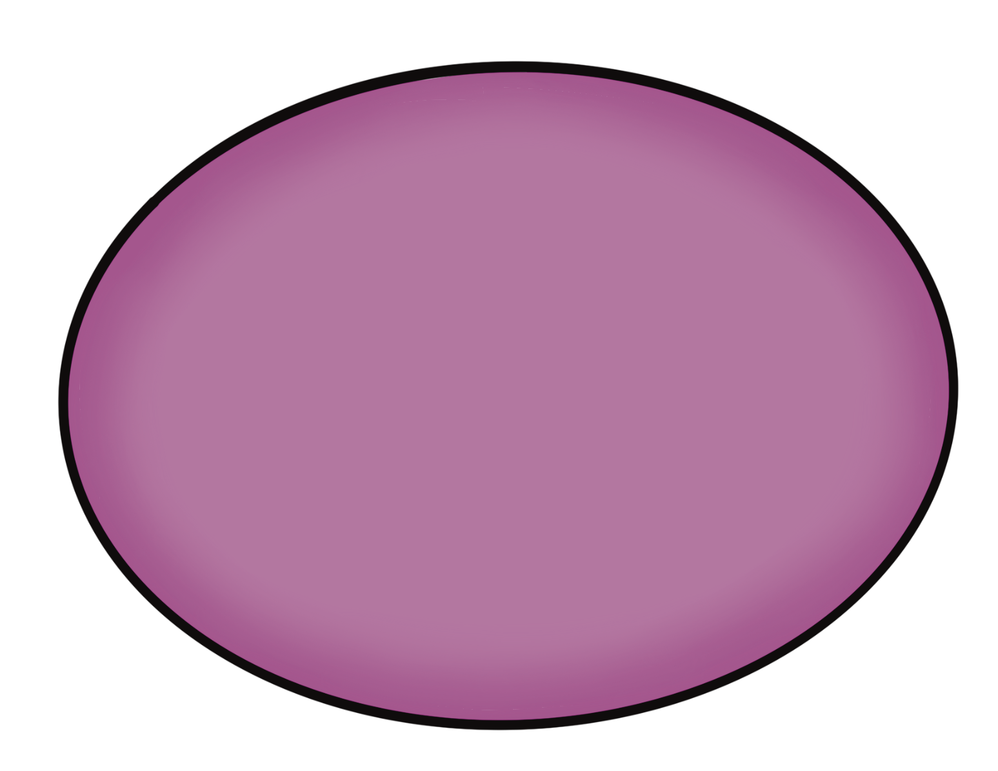
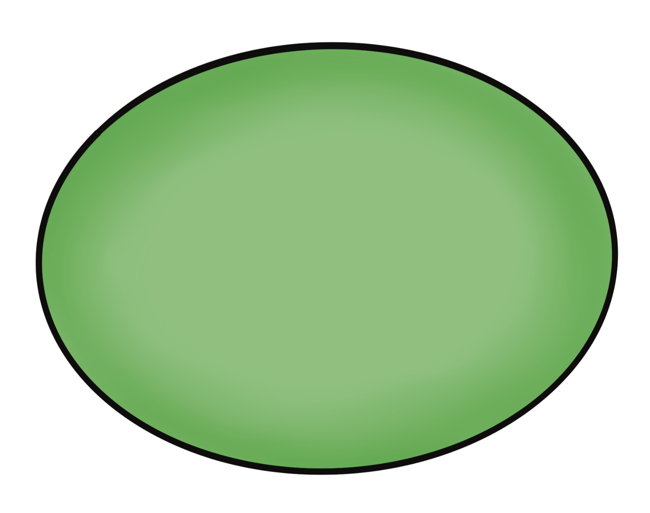
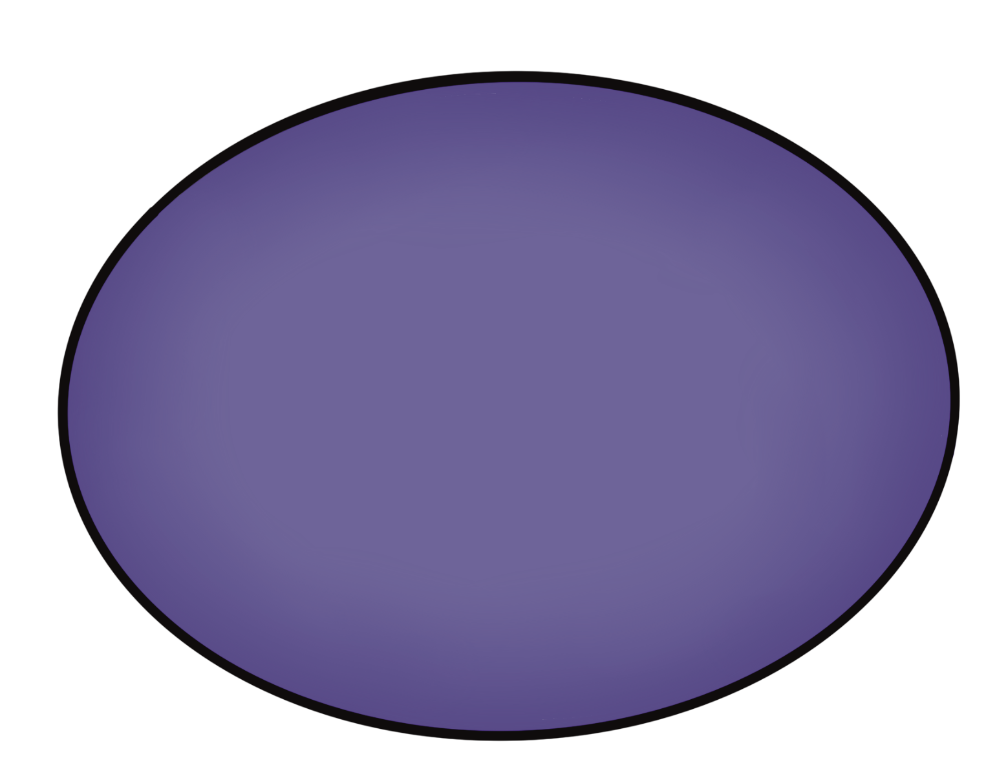
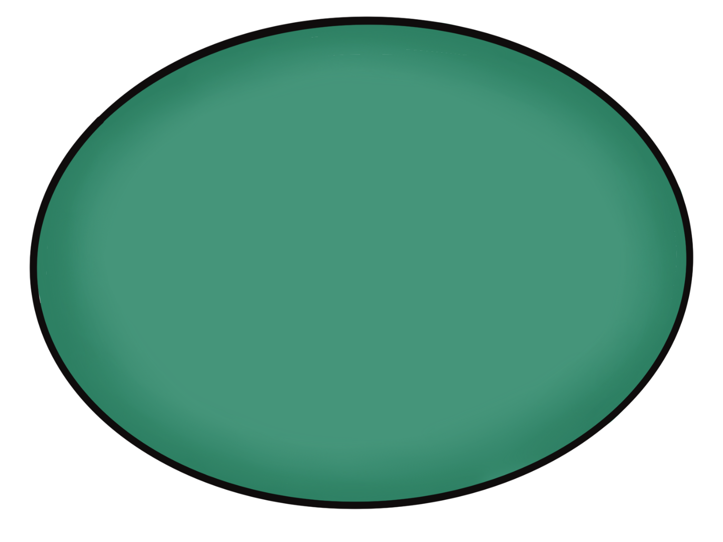

Transport in the Nephron Tubule
EveryBody Physiology
Artist: Danielle Xin
Notes:
Diagram Title: Transport in the Nephron Tubule
Description: This diagram supports the teaching of various types of tubule transport. Utilize these protein carriers and channels to highlight the various mechanisms of transport in the various segments of the nephron tubule.
Usage & Licensing:
This diagram is licensed under CC BY-NC-ND 4.0.
You may add or remove labels, rearrange layers, or adapt layout for educational use.
Attribution: Danielle Xin

