Slide 1
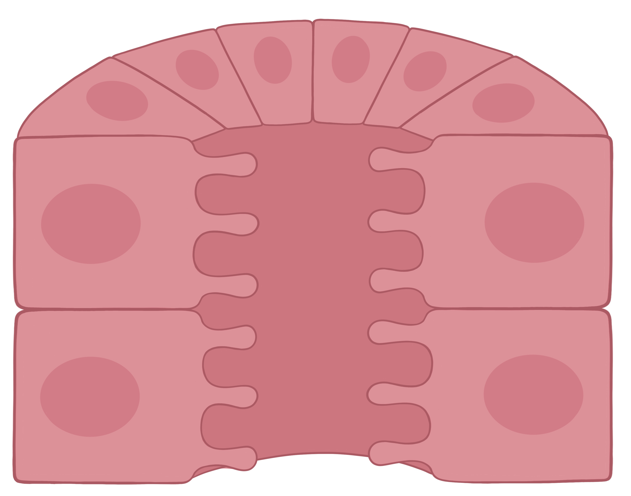
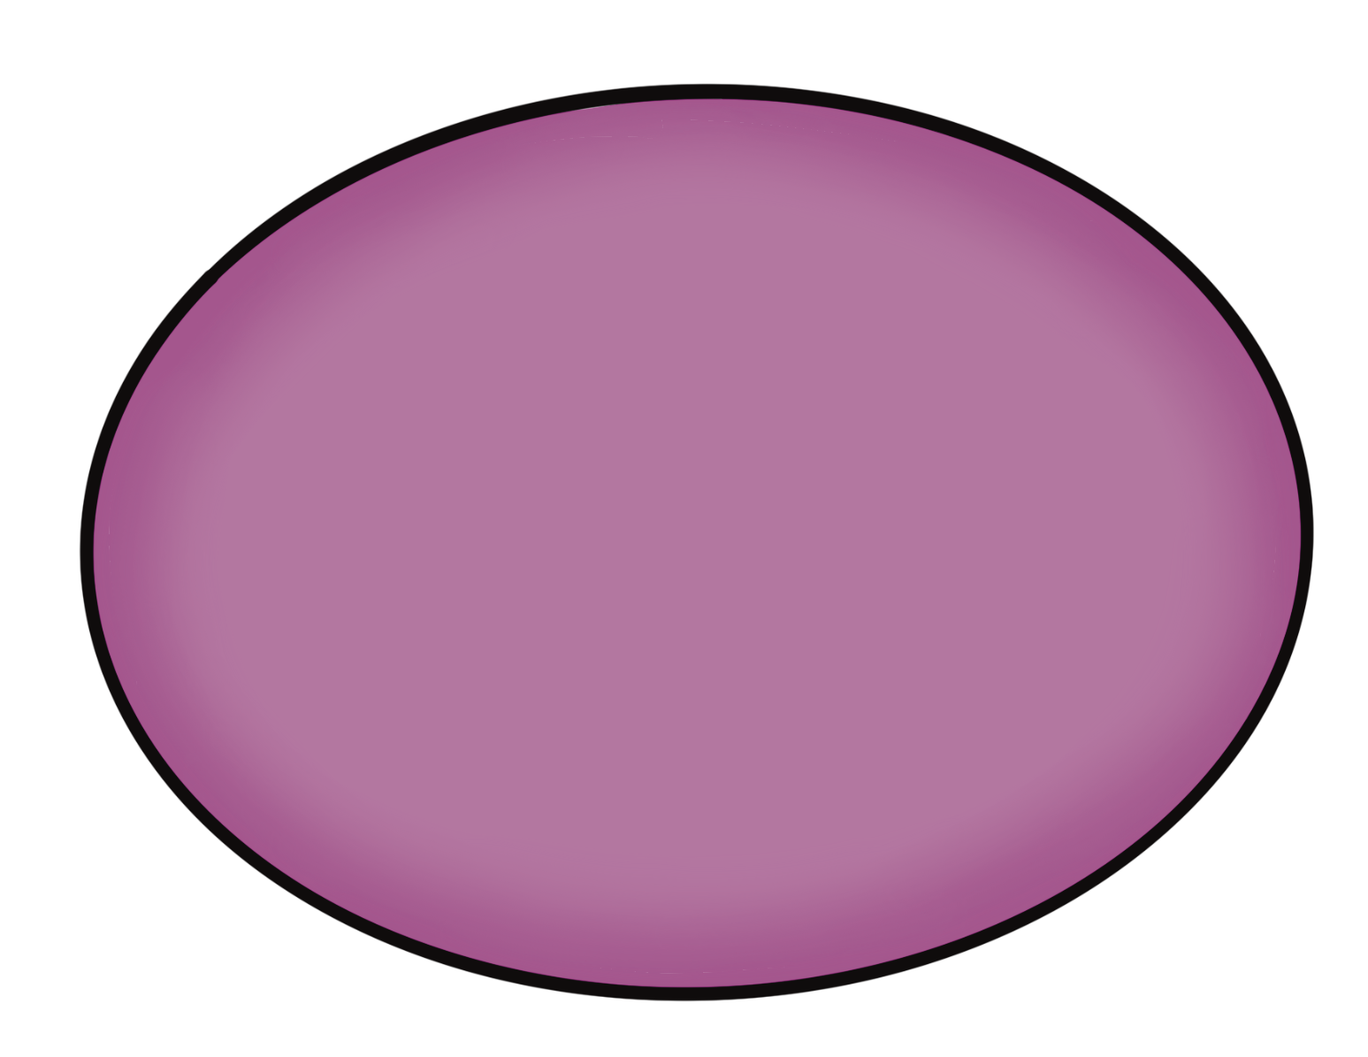
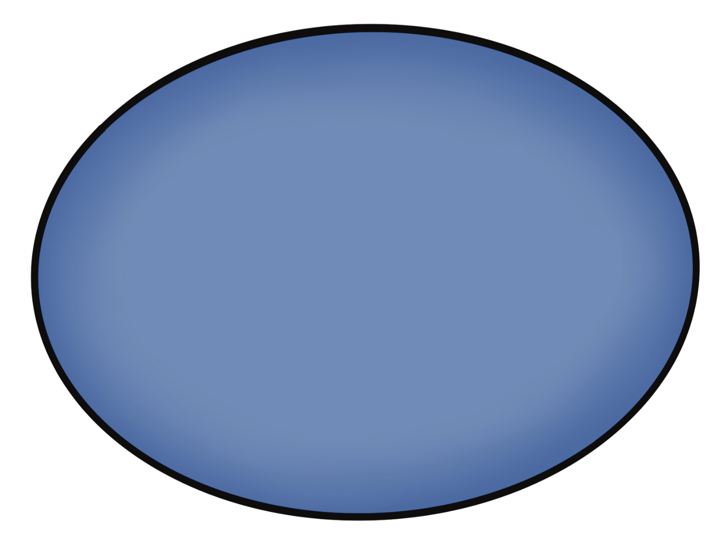


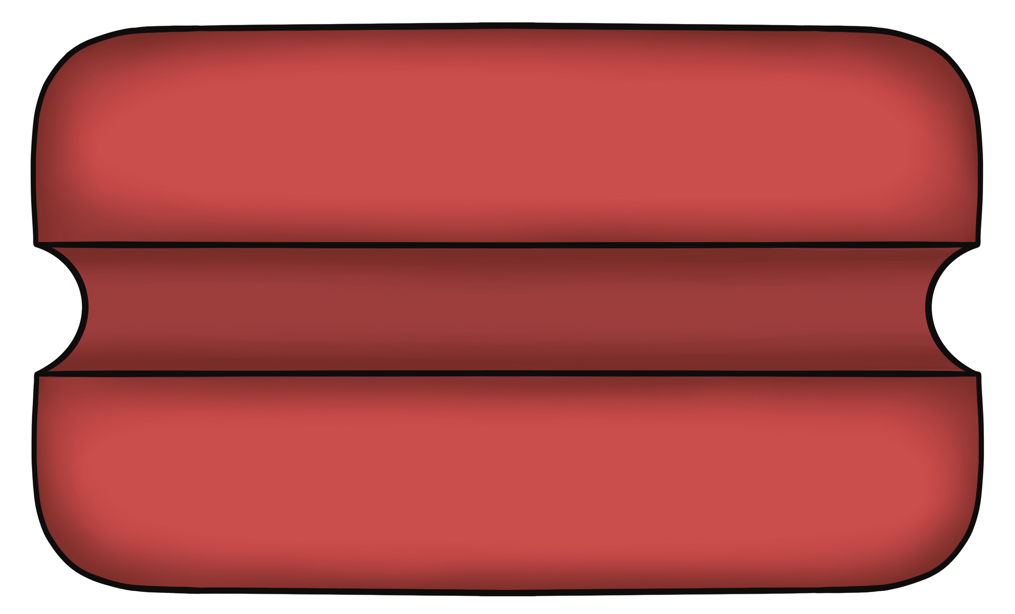

Transport of the Thick Ascending Limb of the Nephron Loop
Apical Membrane
Basolateral Membrane
Tubule Lumen
3 Na⁺
+ATP
2 K⁺
Na⁺, Mg²⁺, Ca²⁺
Na⁺
Cl⁻
2 Cl⁻
K⁺
K⁺
K⁺
Cl⁻
EveryBody Physiology
Artist: Danielle Xin
Notes:
Diagram Title: Transport of the Thick Ascending Limb of the Nephron Loop
Description: This diagram depicts a cross-section of the thick limb portion of the ascending limb of the nephron loop with some of the major transport that occurs in this tubule region. Apical transporters include the ion multiplier, also known as the sodium/chloride/potassium cotransporter (NKCC2), and potassium channels. The basolateral membrane expresses a potassium/chloride symporter and chloride channels, as well as the sodium/potassium ATPase. Paracellular reabsorption allows for the movement of sodium and the divalent cations, magnesium and calcium.
Usage & Licensing:
This diagram is licensed under CC BY-NC-ND 4.0.
You may add or remove labels, rearrange layers, or adapt layout for educational use.
Attribution: Danielle Xin

