Slide 1
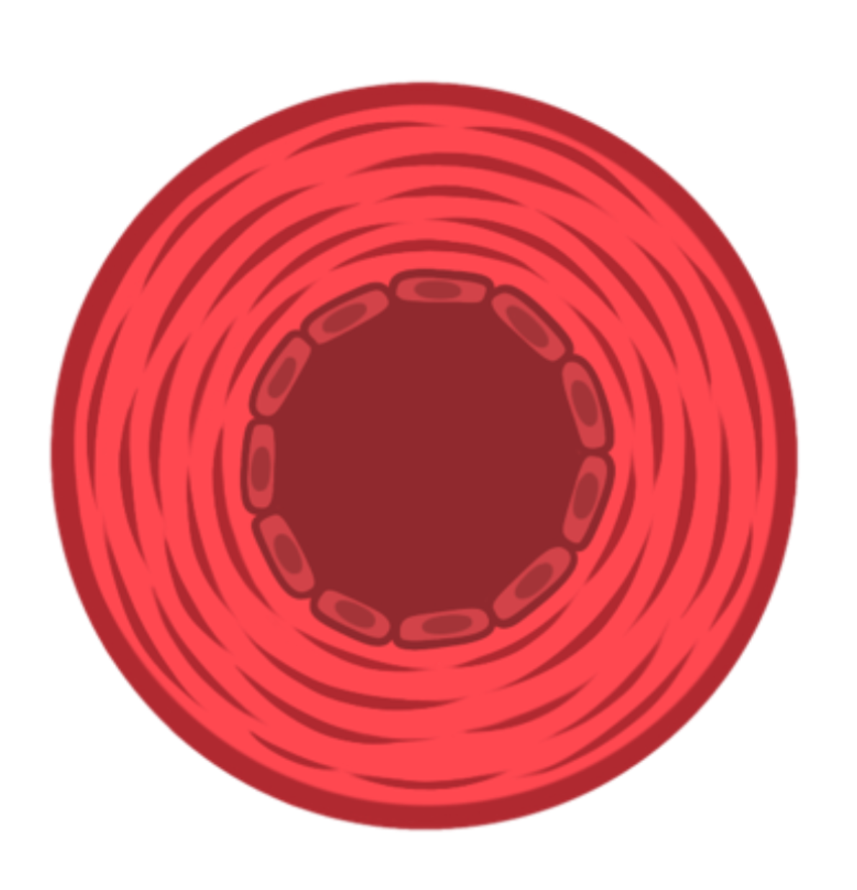
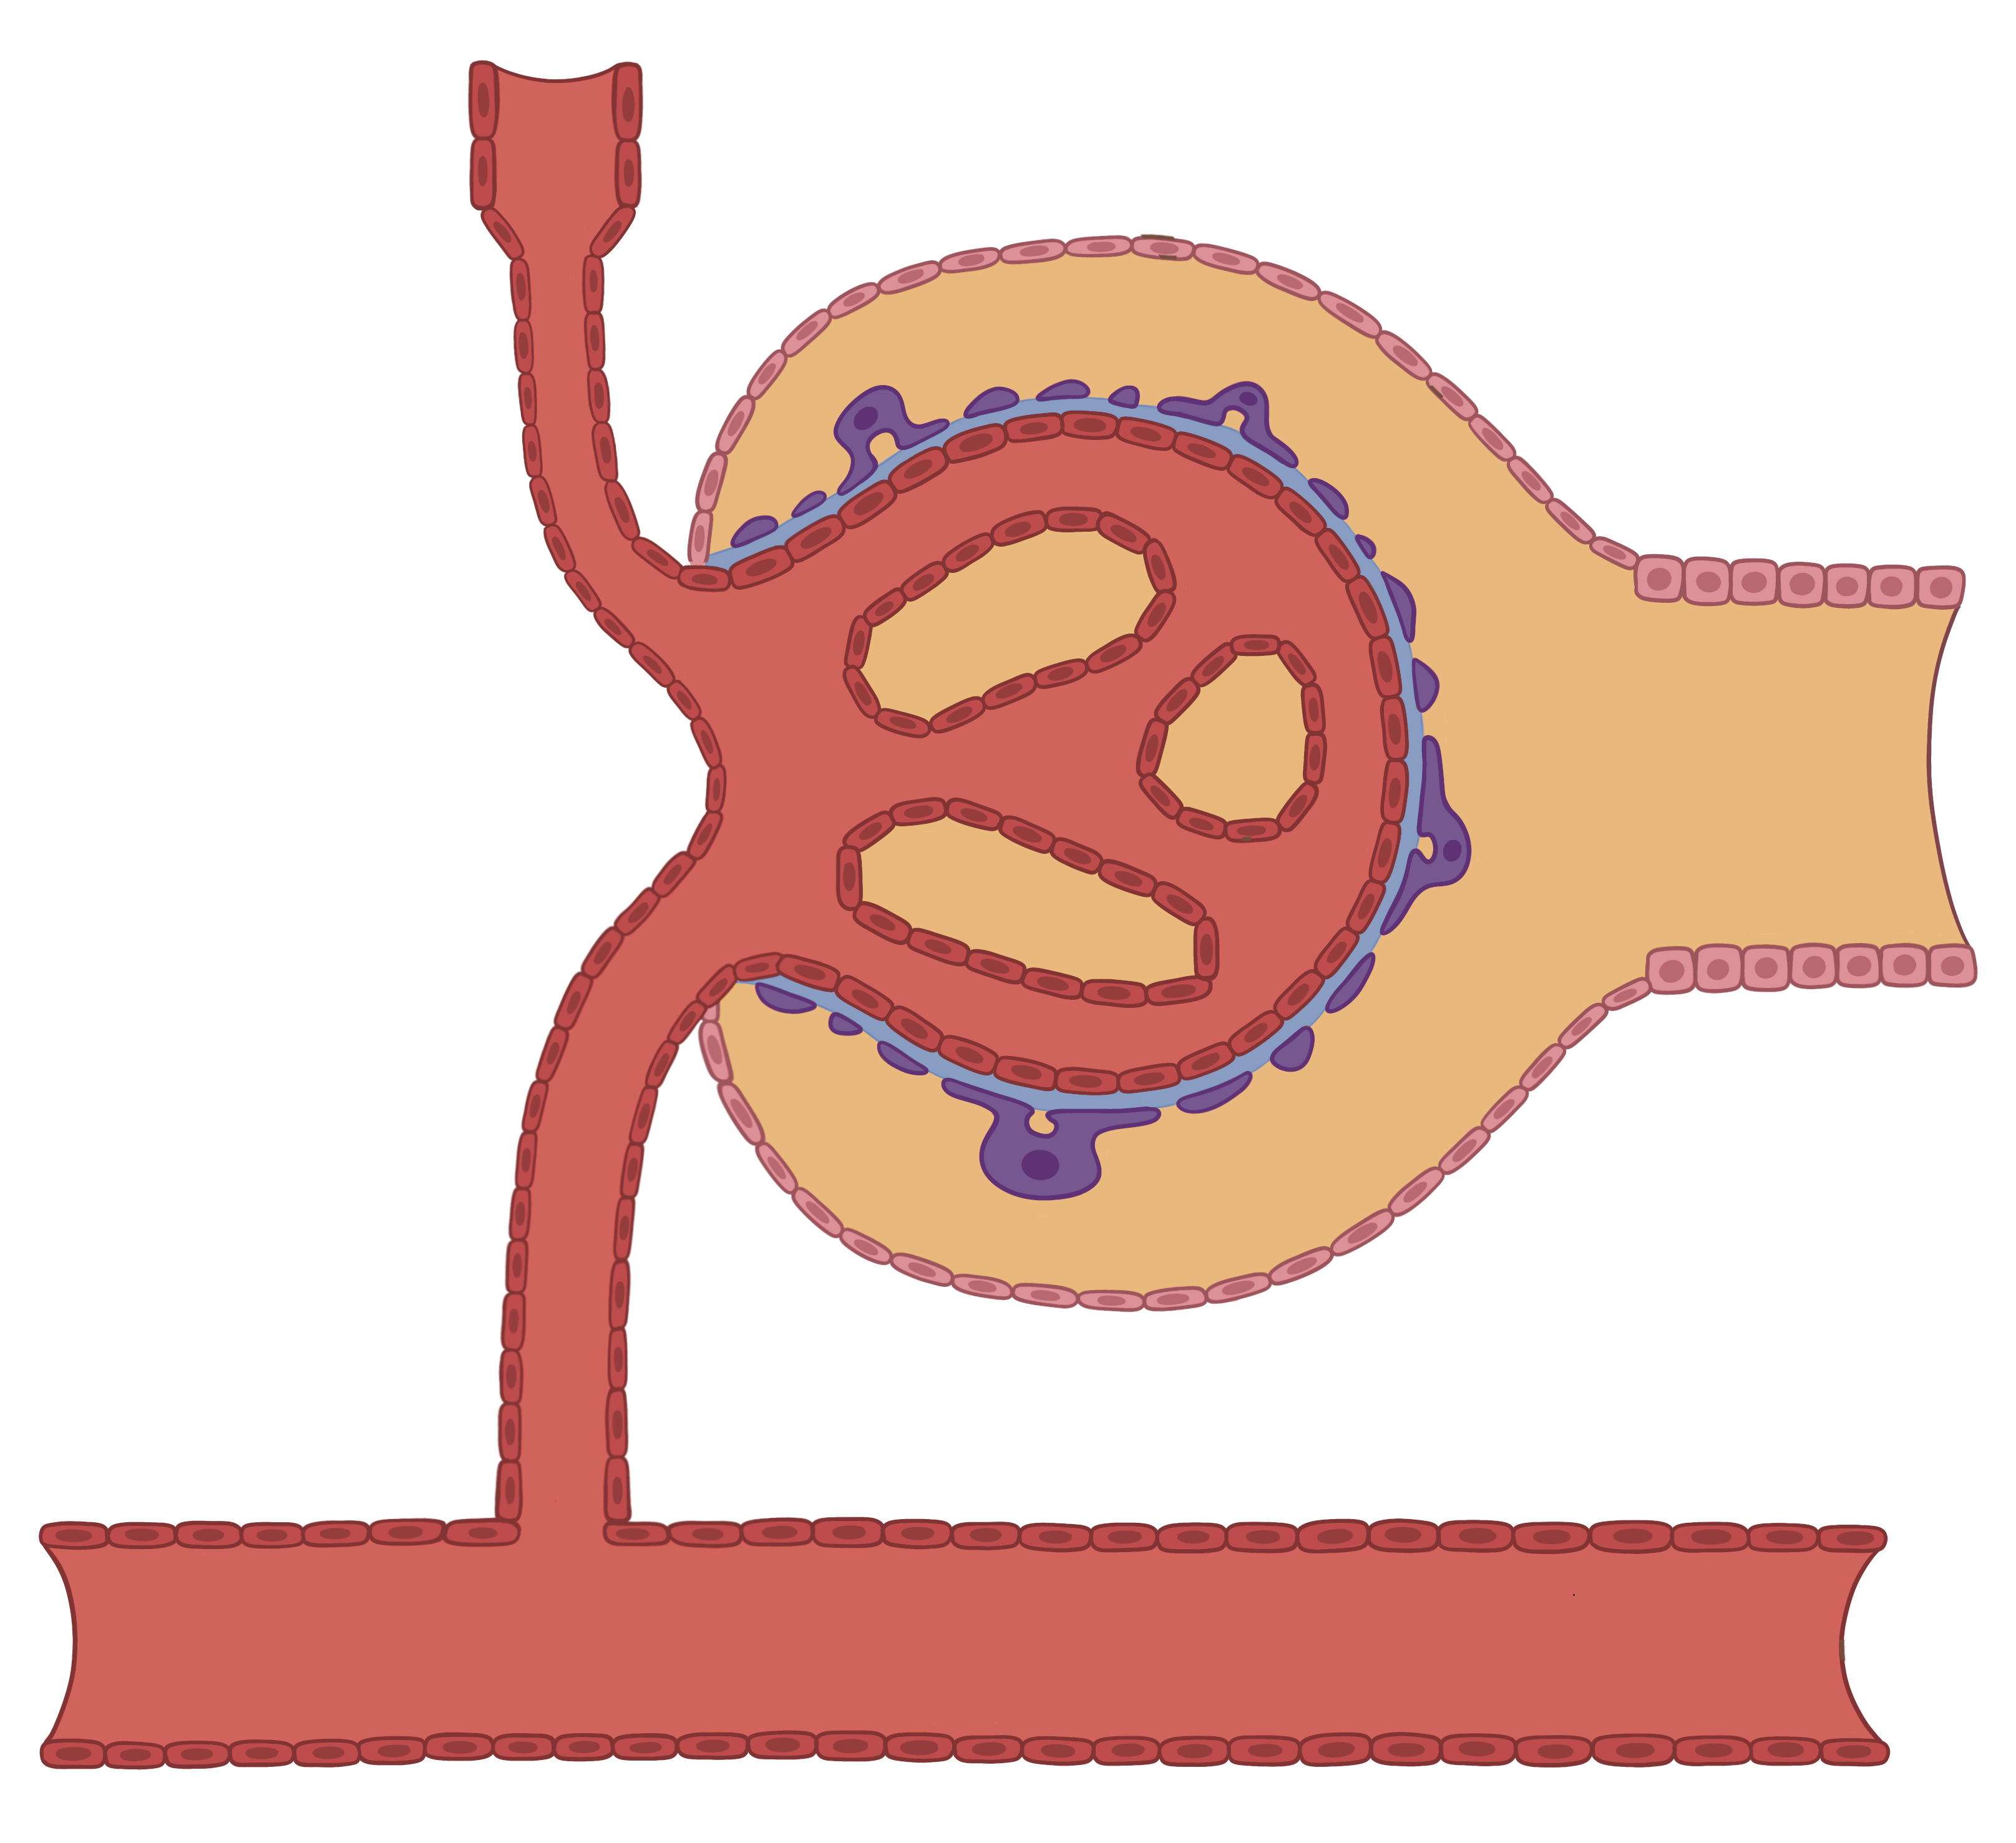

Vasoconstriction of the Efferent Arteriole
Renal capsule
Efferent arteriole
Vasoconstriction
GFR
Afferent arteriole
EveryBody Physiology
Artist: Danielle Xin
Notes:
Diagram Title: Vasoconstriction of the Efferent Arteriole
Description: This diagram depicts the impact of vasoconstriction of the efferent arteriole on blood flow to the nephron and change to the glomerular filtration rate.
Usage & Licensing:
This diagram is licensed under CC BY-NC-ND 4.0.
You may add or remove labels, rearrange layers, or adapt layout for educational use.
Attribution: Danielle Xin

