Slide 1
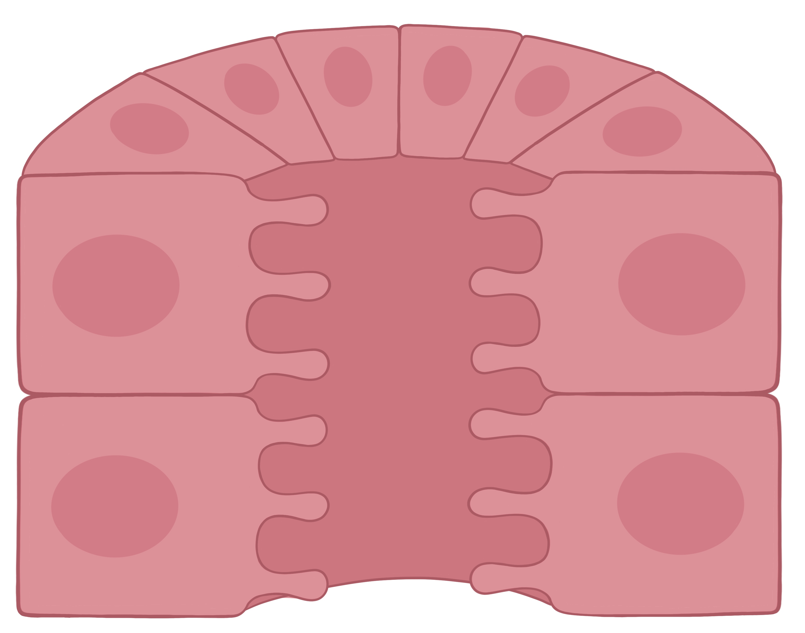
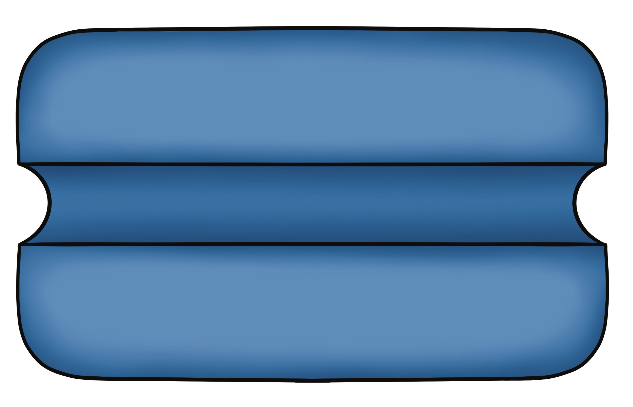




Transport of Principal Cells of the Collecting Duct
Apical Membrane
Basolateral Membrane
Tubule Lumen
3 Na⁺
H₂O
H₂O
Na⁺
+ATP
2 K⁺
K⁺
K⁺
EveryBody Physiology
Artist: Danielle Xin
Notes:
Diagram Title: Transport of the Principal Cells of the Collecting Duct
Description: This diagram depicts a cross-section of the collecting duct, specifically the principal cells of this tubule region. The apical membrane of principal cells can express a water channel, as well as a sodium channel. In addition, two important types of apical potassium channels are the big capacitance (BK) channel and the renal outer medulla potassium channel (ROMK). The basolateral membrane has an aquaporin channel and the sodium potassium ATPase.
Usage & Licensing:
This diagram is licensed under CC BY-NC-ND 4.0.
You may add or remove labels, rearrange layers, or adapt layout for educational use.
Attribution: Danielle Xin

