Slide 1
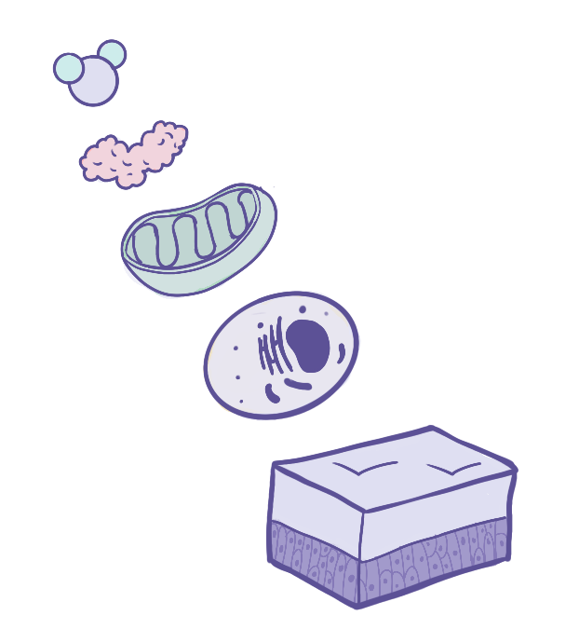
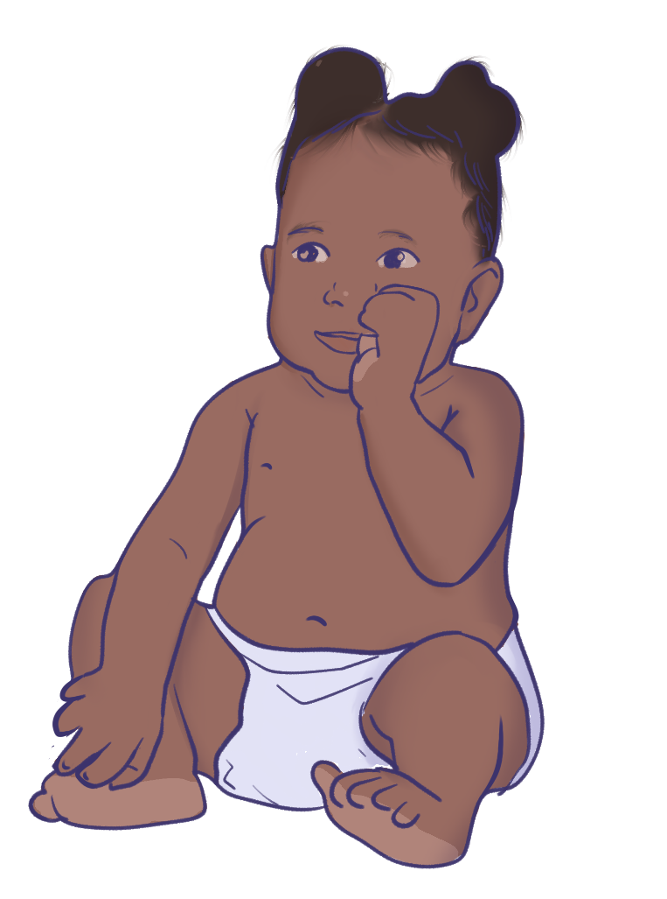
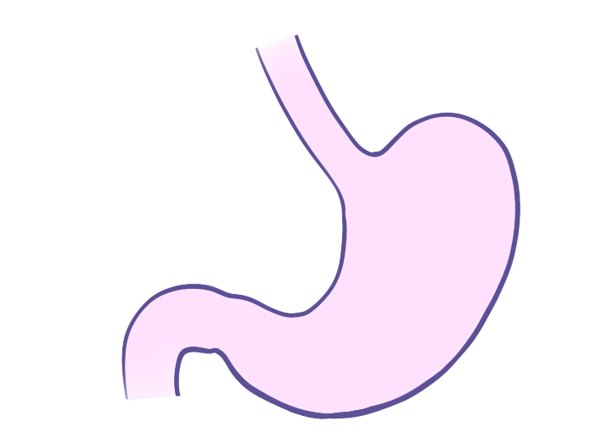
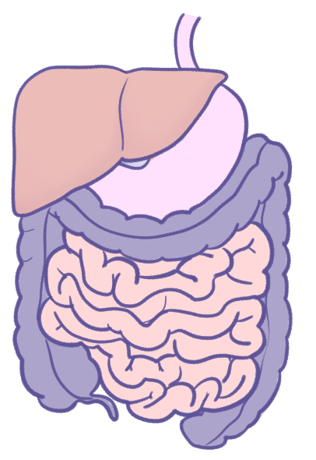

From Cells to Systems
Biomolecule
Protein
Organelle
Cell
Tissue
Organ
Organ System
EveryBody Physiology
Artist: Priya Modi
Notes:
Diagram Title: From Cells to Systems
Description: This illustration shows the levels of structural organization in the human body, from a single biomolecule to a complete organism. Biomolecules assemble into larger macromolecules such as proteins. Also, a component of smaller scale are the organelles that compose our cells, the smallest unit of life. Similar cells group into tissues, different tissues combine to form organs, and organs that share a common function make up organ systems. Together, these systems make up the organism, represented here by an infant.
Much of human physiology is taught at the organ and organ-system level. Yet many physiological processes, such as muscle contraction, nerve signalling and hormone action, can only be fully explained by looking at the cells, organelles and molecules involved. This figure can help students see how each level builds on the one below it, and why we sometimes need to move between levels to understand how the body works.
Usage & Licensing:
This diagram is licensed under CC BY-NC-ND 4.0.
You may add or remove labels, rearrange layers, or adapt layout for educational use.
Attribution: Priya Modi

