Slide 1
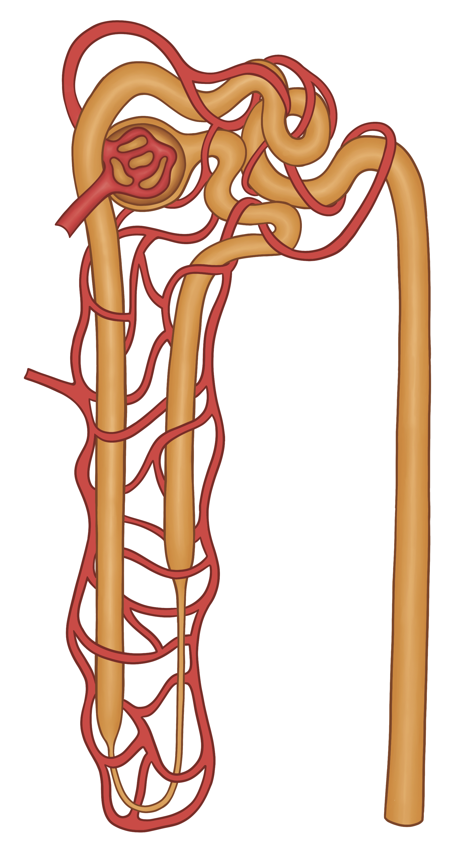

Nephron Blood Vessels
Efferent Arteriole
Peritubular Capillaries
Glomerulus
Afferent Arteriole
Venule
EveryBody Physiology
Artist: Danielle Xin
Notes:
Diagram Title: Nephrons Blood Vessels
Description: This diagram shows the relationship between blood vessels and the nephron. The afferent arteriole brings blood to each renal capsule. The capillary bed within the renal capsule is the glomerulus. The efferent arteriole brings blood out of the renal capsule. A second capillary bed, called the peritubular capillaries, surround the tubule portion of each nephron. A venule brings blood away from the nephron.
Usage & Licensing:
This diagram is licensed under CC BY-NC-ND 4.0.
You may add or remove labels, rearrange layers, or adapt layout for educational use.
Attribution: Danielle Xin

